Slide 1
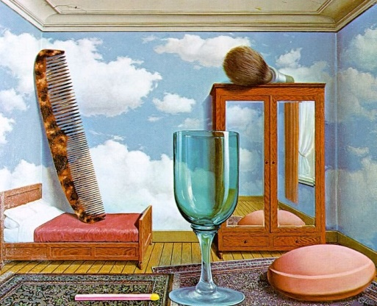
Art With Elders
AWEsome Art with Darcie www.artwithelders.org
Magritte, Les Valeurs Personnelles (Personal Values), 1952
Still Life: Personal Values

Slide 2
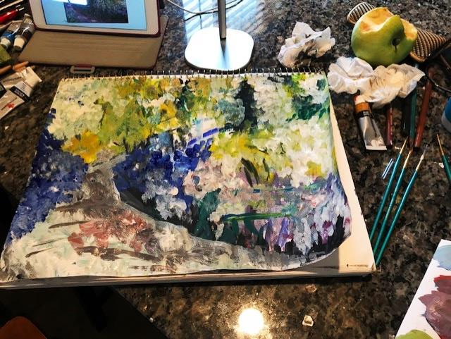
Recent Works
Pamela

Slide 3
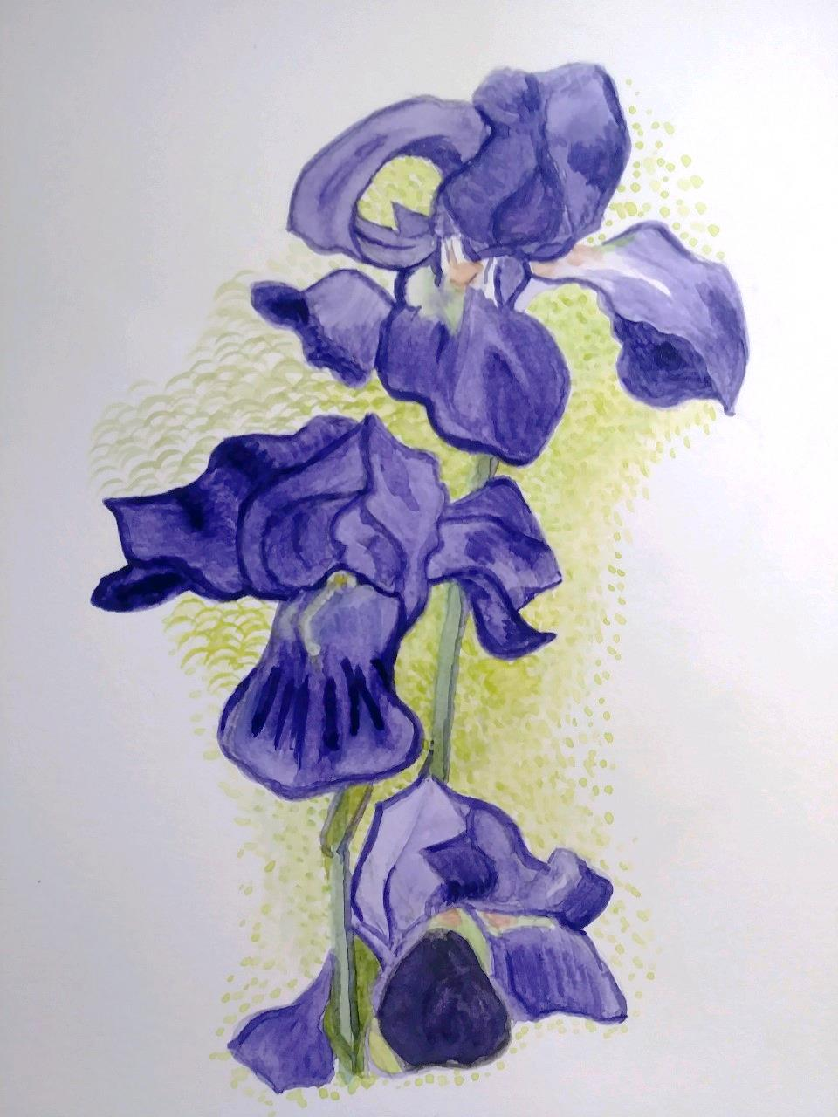
Recent Works
Melinda

Slide 4
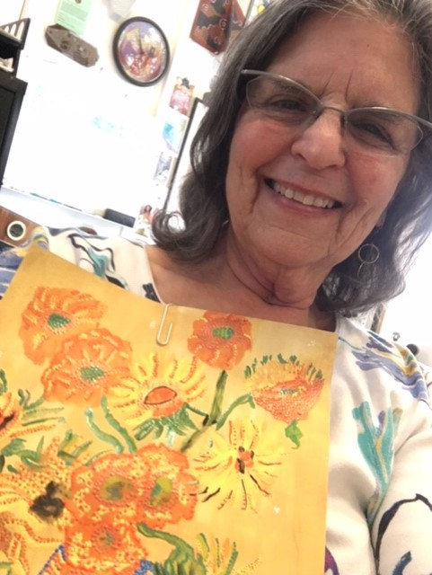
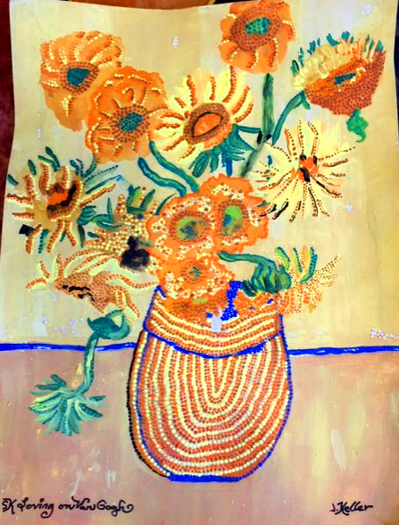
Recent Works
Shirley

Slide 5
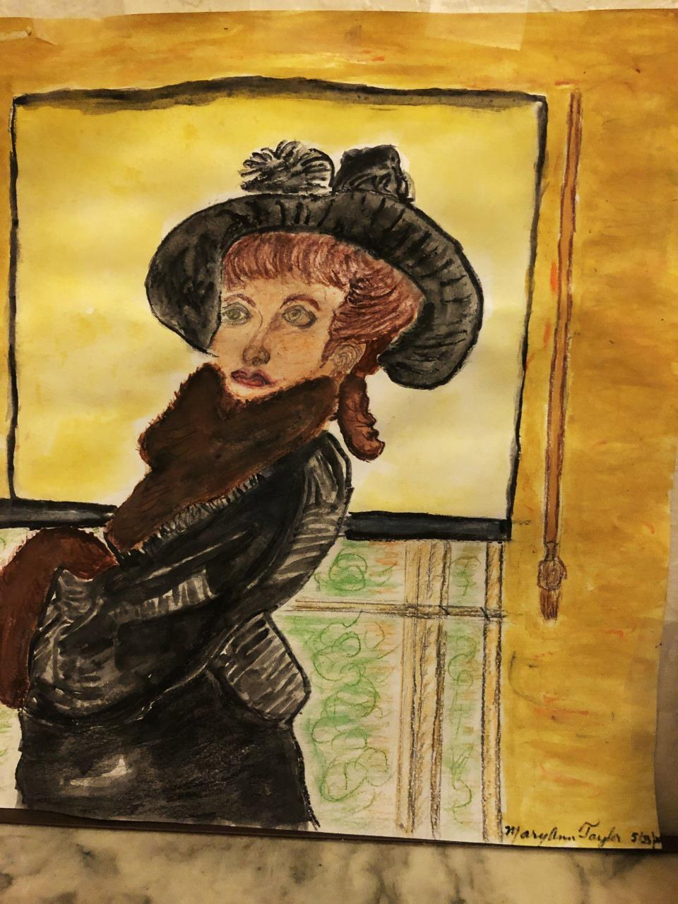
Recent Works
Mary Ann

Slide 6
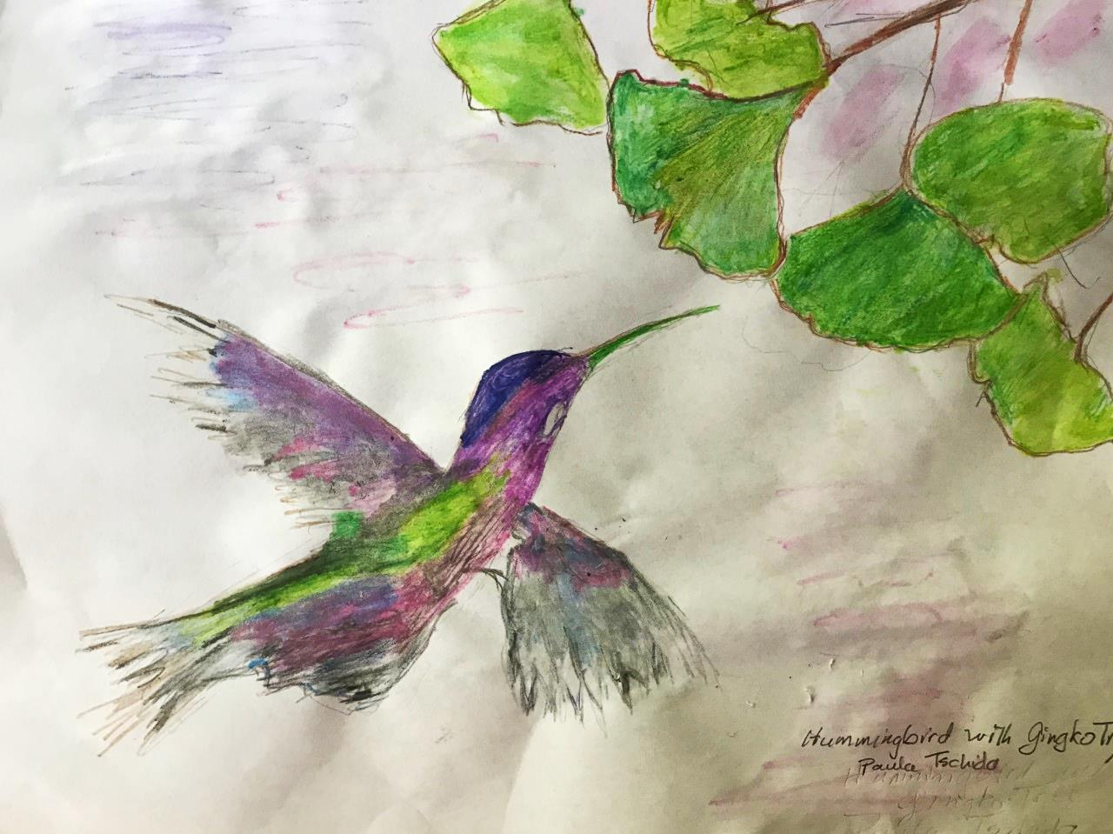
Recent Works
Paula

Slide 7
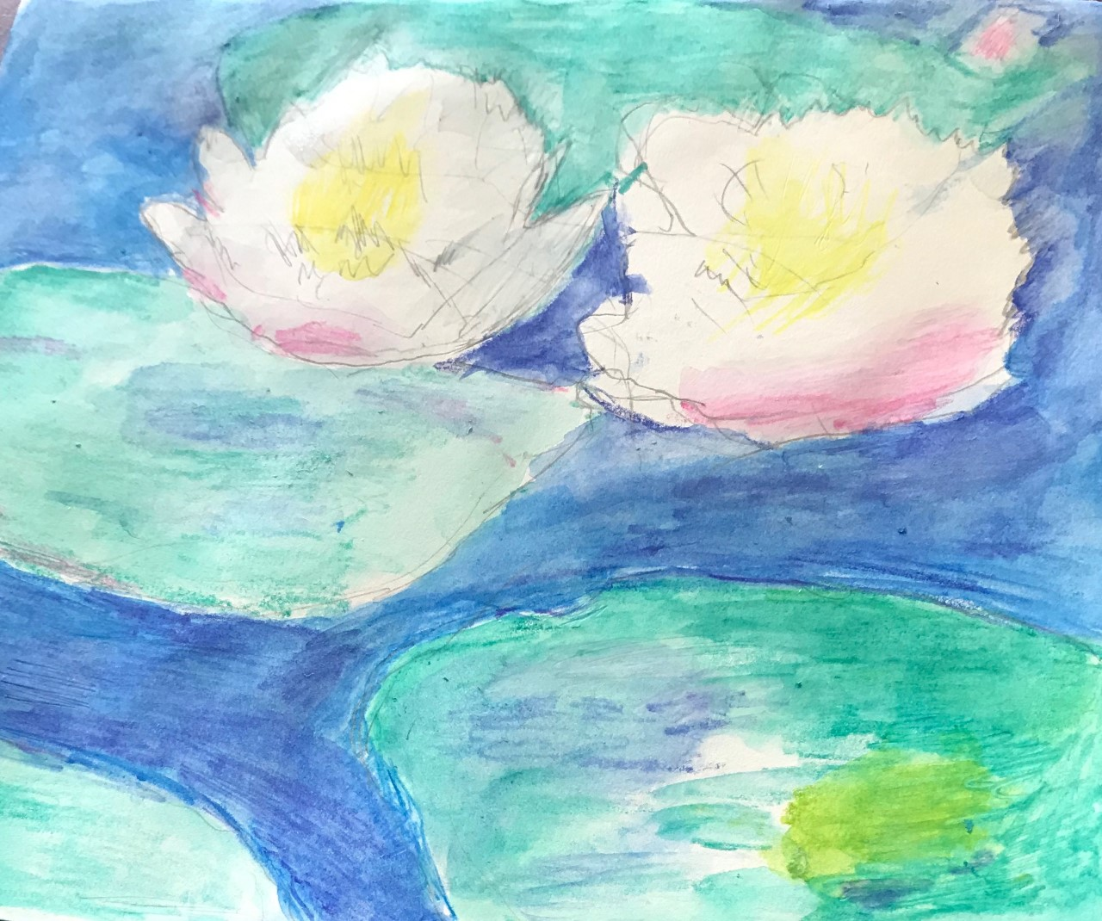
Recent Works
Paula

Slide 8
Recent Works
Kay

Slide 9
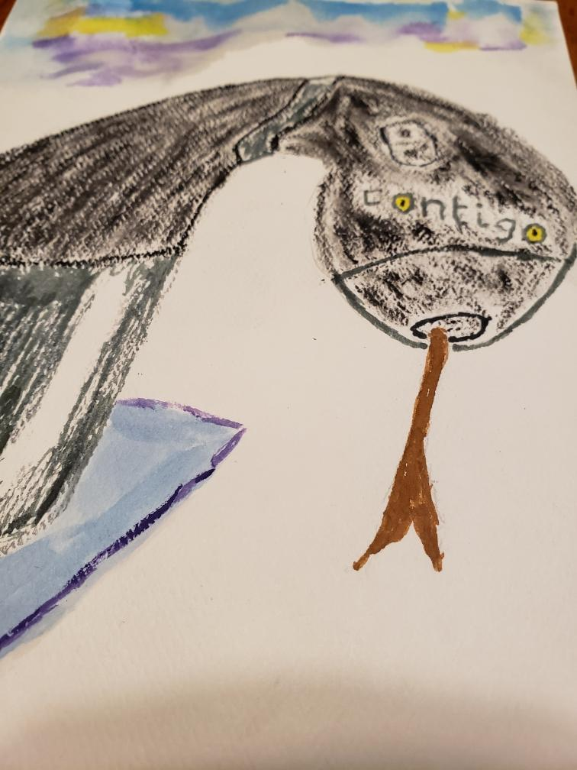
Recent Works
John

Slide 10
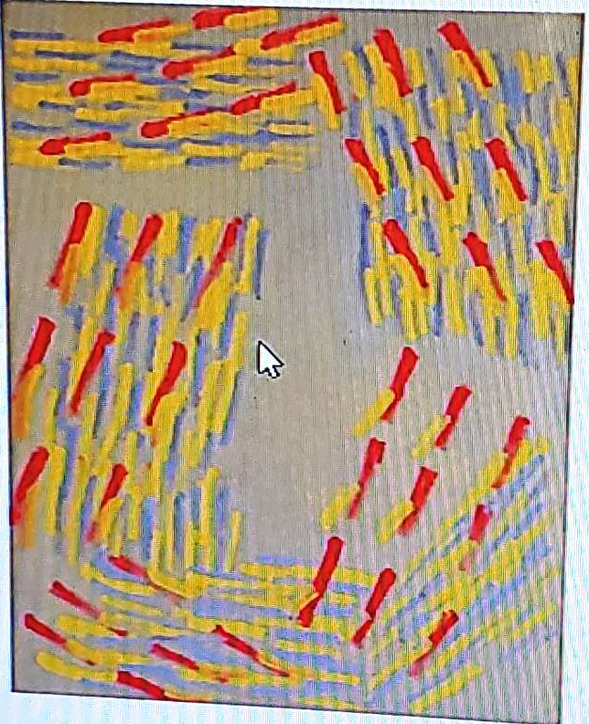
Recent Works
Sandra

Slide 11
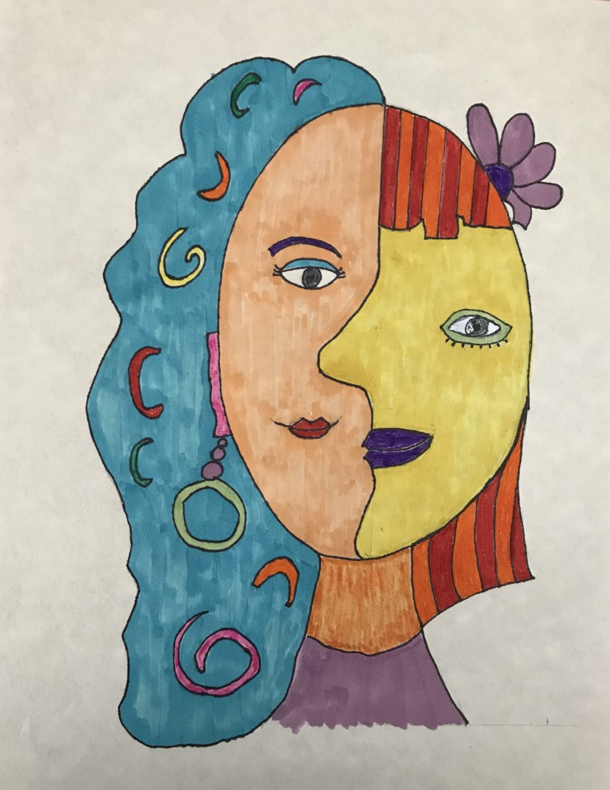
Recent Works
Fran

Slide 12
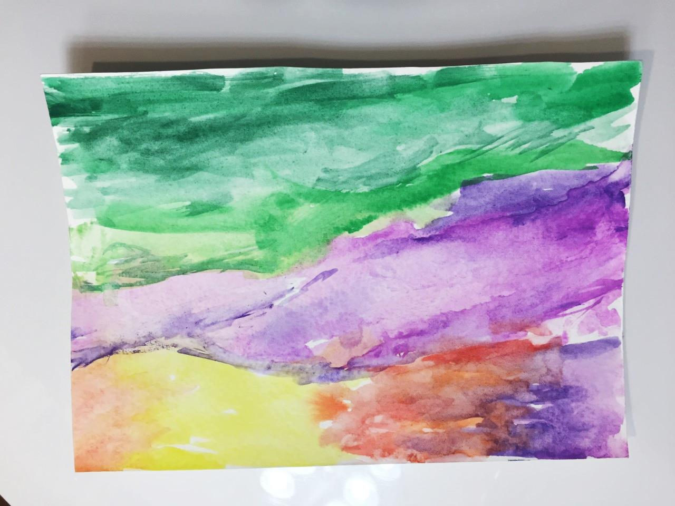
Recent Works
Susan

Slide 13
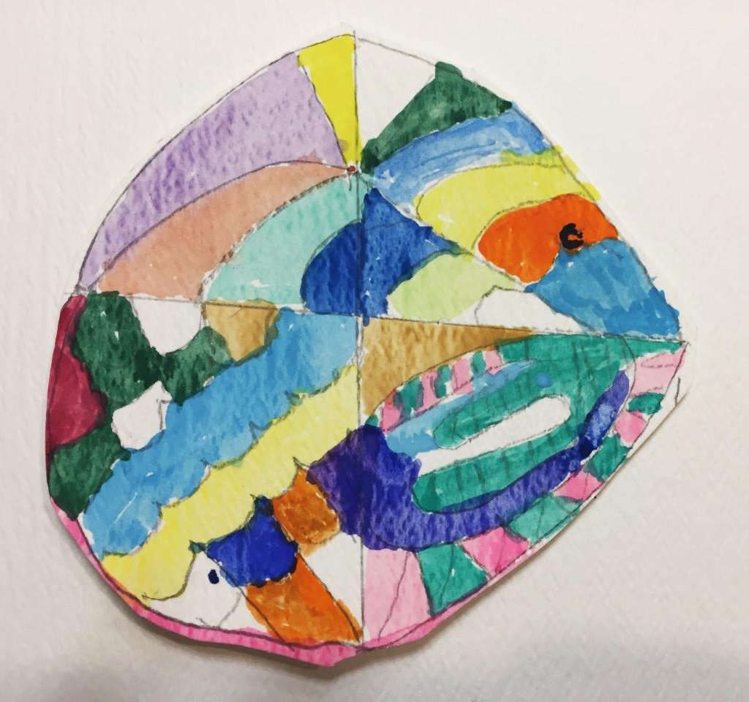
Recent Works
Susan

Slide 14
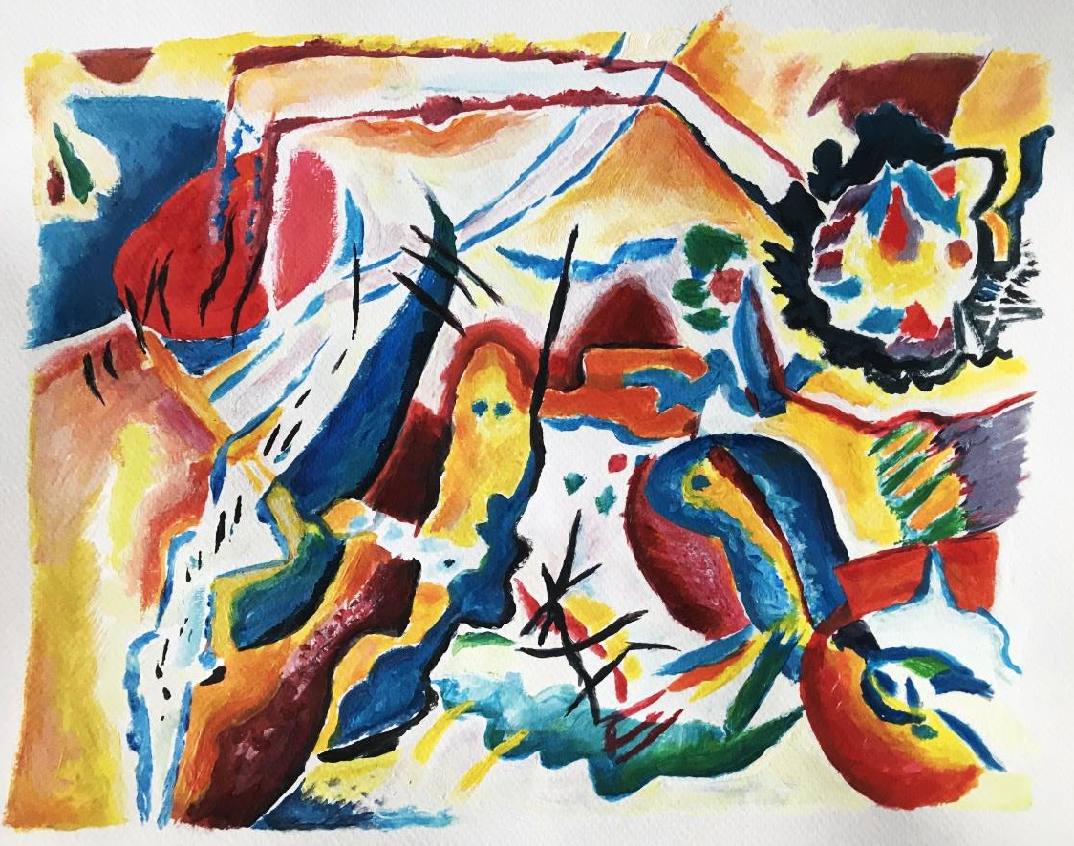
Recent Works
Darcie

Slide 15
Still Life: Personal Values
“There is no must in art because art is free.” Wassily Kandinsky
“Make your art a gift of inspiration to others to work toward better things.” Richard Schmid
“Creativity is contagious, pass it on.” Albert Einstein

Slide 16
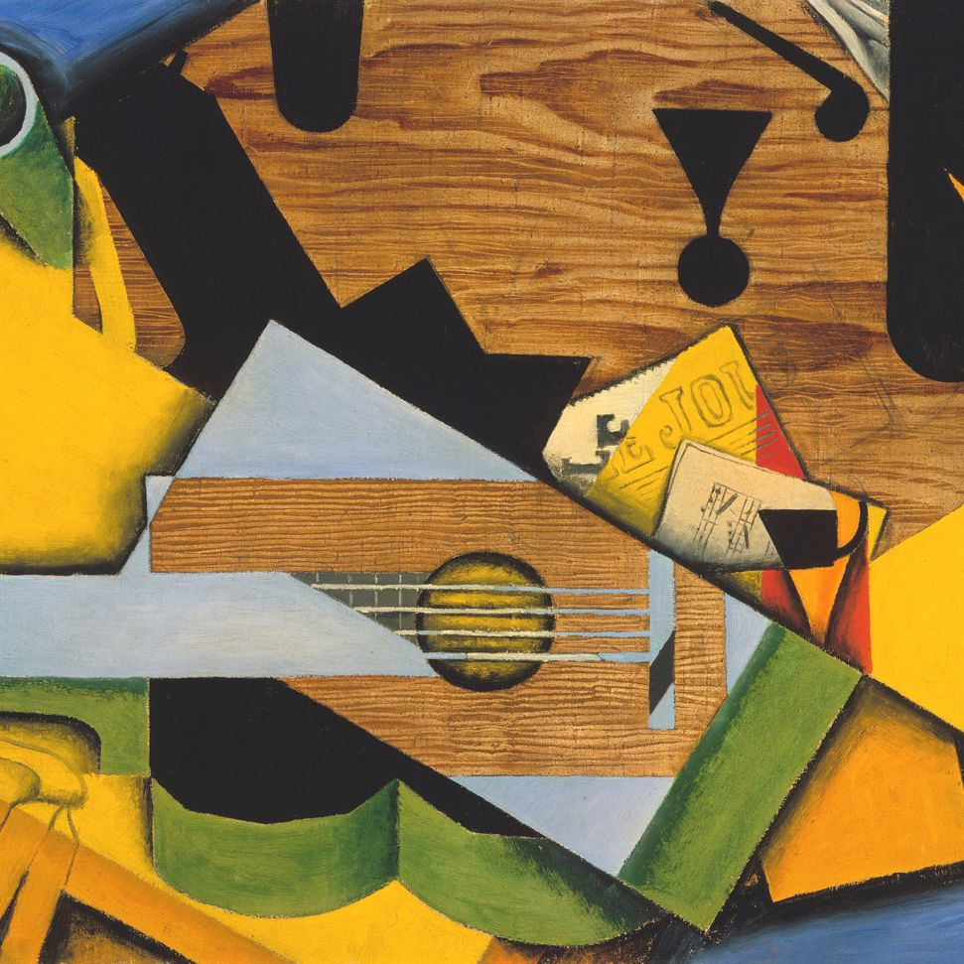
Still Life: Personal Values
Prepare:
Select some objects from around your home that reflect your personality, your lifestyle, yourself.
Class time:
Arrange your selected objects in a still life composition and create a painting or drawing from your arrangement.

Slide 17
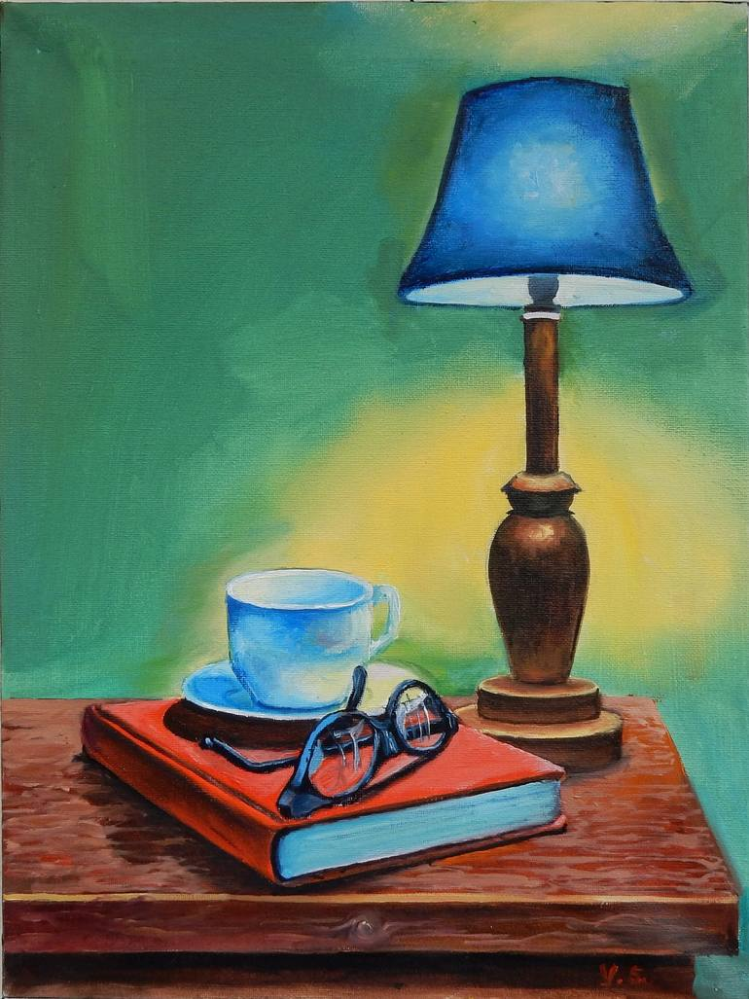
Inspiration – Vita Schagen

Slide 18
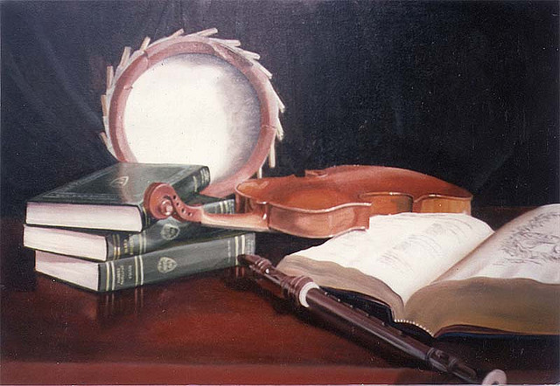
Inspiration – Musical by Buddy McCue

Slide 19
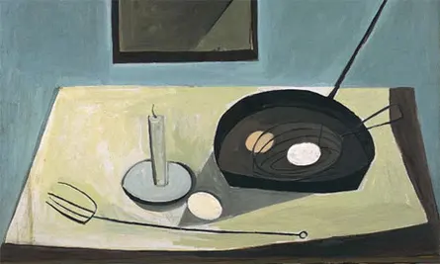
Inspiration – Still Life with Candlestick - William Scott

Slide 20
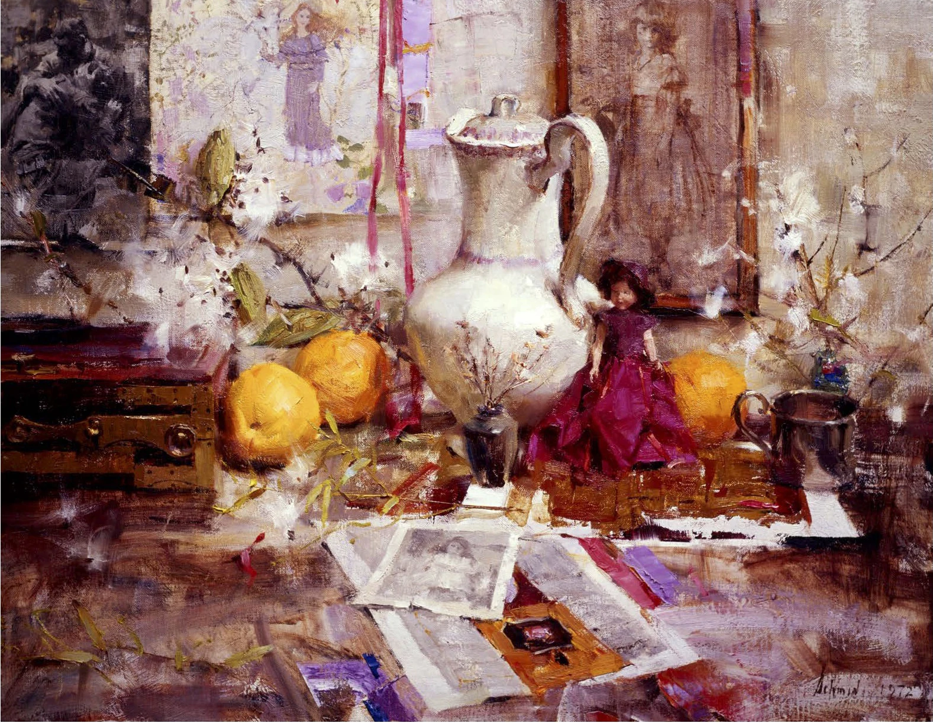
Inspiration – Milkweed by Richard Schmid

Slide 21
Inspiration – Still Life - Guitar - Juan Gris

Slide 22
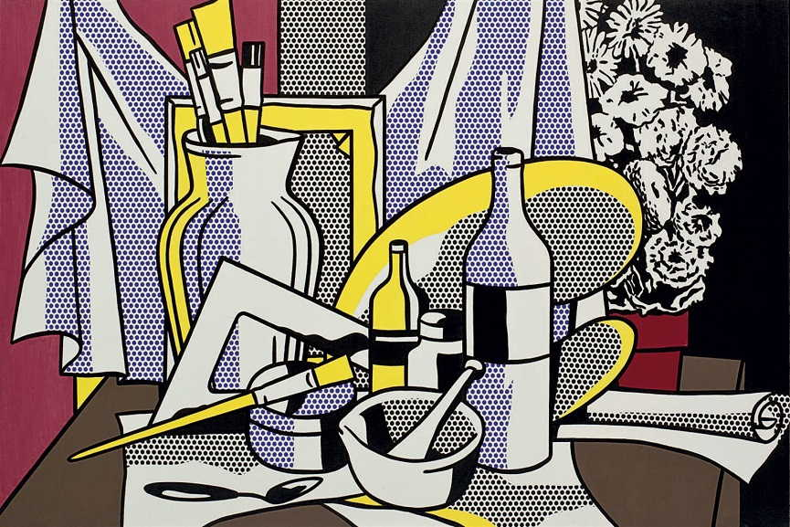
Inspiration – Roy Lichtenstein – Still Life

Slide 23
Inspiration – Magritte - Les Valeurs Personnelles (Personal Values) - 1952

Slide 24
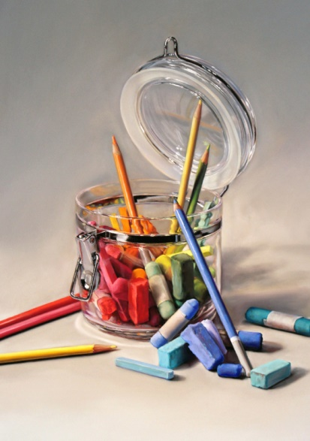
Inspiration – Lisa Ober

Slide 25
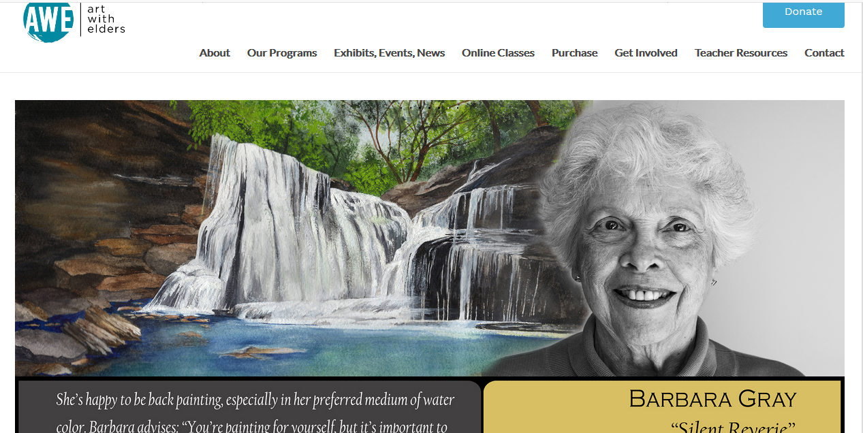
Art With Elders
AWEsome Art www.artwithelders.org
AWE Website
Is it working for you?

Slide 26
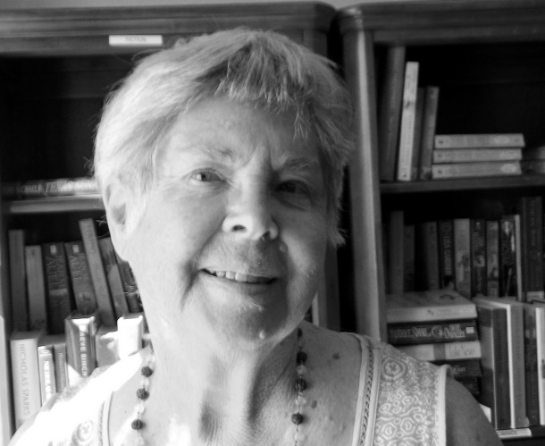
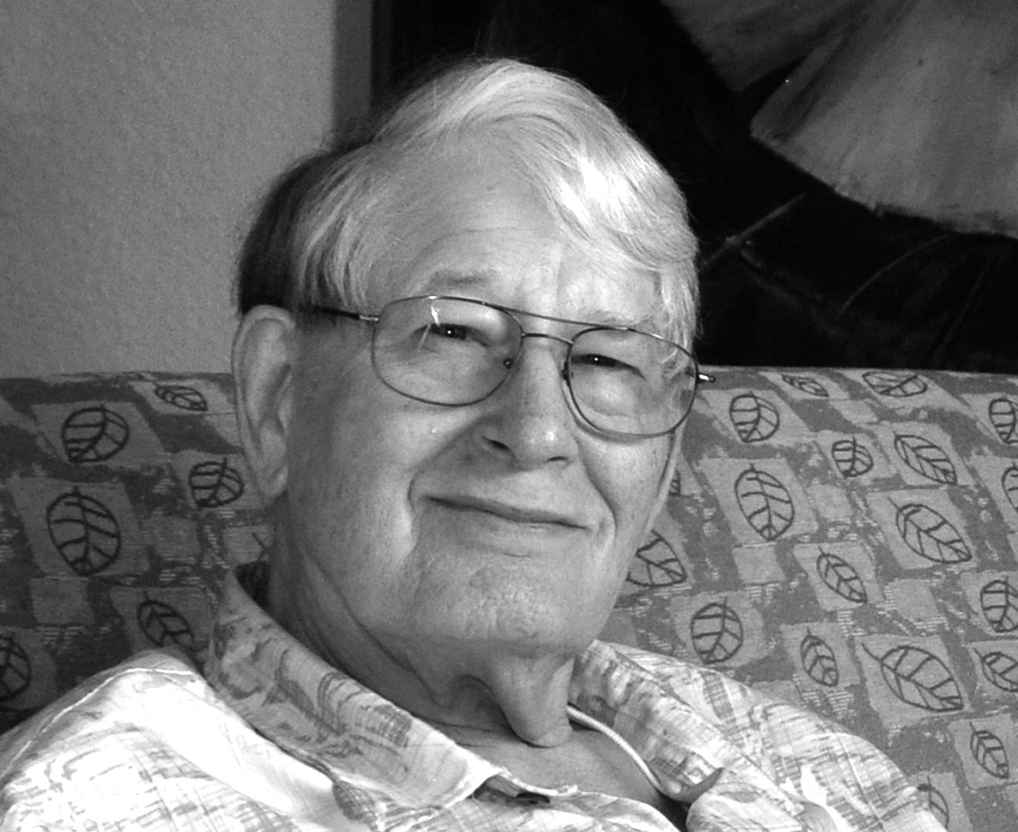
Art With Elders
AWEsome Art www.artwithelders.org
Exhibitions
Take the best photo of your work that you can.
Take a pic of you with your work.
Send me a photo of yourself that will represent you with your work, head and shoulders.
Create a brief biography and/or artist’s statement.
I will send you a release form to sign that says you agree to have your art and pictures exhibited to the public.
Ruth’s Table: Please send us a short story behind your creative project, image (if applicable), and short bio (2-3 sentences). June 1.

Slide 27
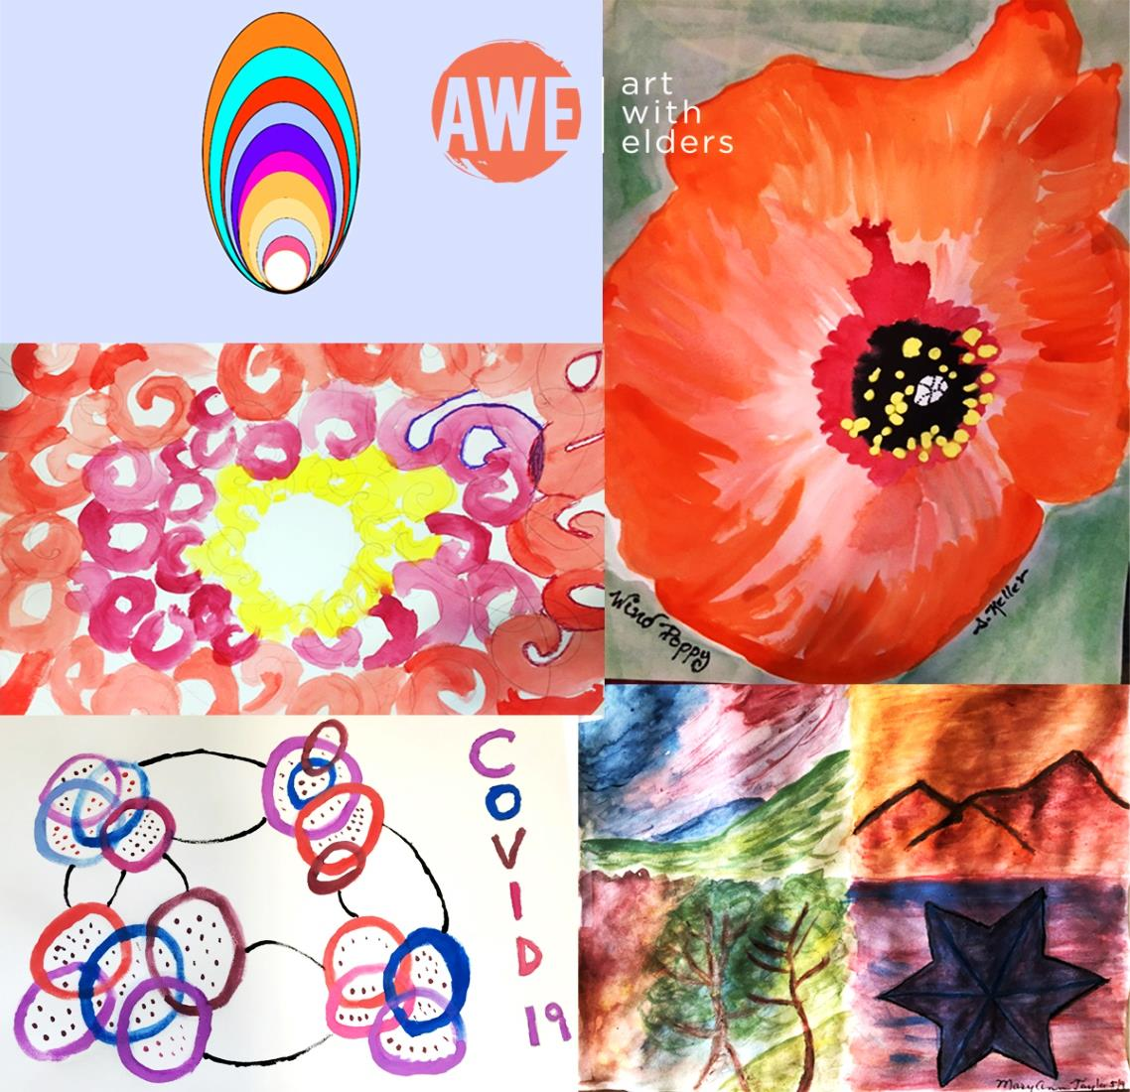
Art With Elders
AWEsome Art www.artwithelders.org
I hope you will enjoy and find value in our session. Your support helps keep our program and our artist instructors going. If you are able to give a donation for this class, we would greatly appreciate it. Thank you!
Donations may be made on our website at: www.artwithelders.org
Or by check, mail to:
Art With Elders
236 West Portal Ave. #845
San Francisco, CA 94131

