Slide 1
Art With Elders
AWEsome Art with Darcie www.artwithelders.org
Portrait by Florent Farges
Portraits: Drawing the Face

Slide 2
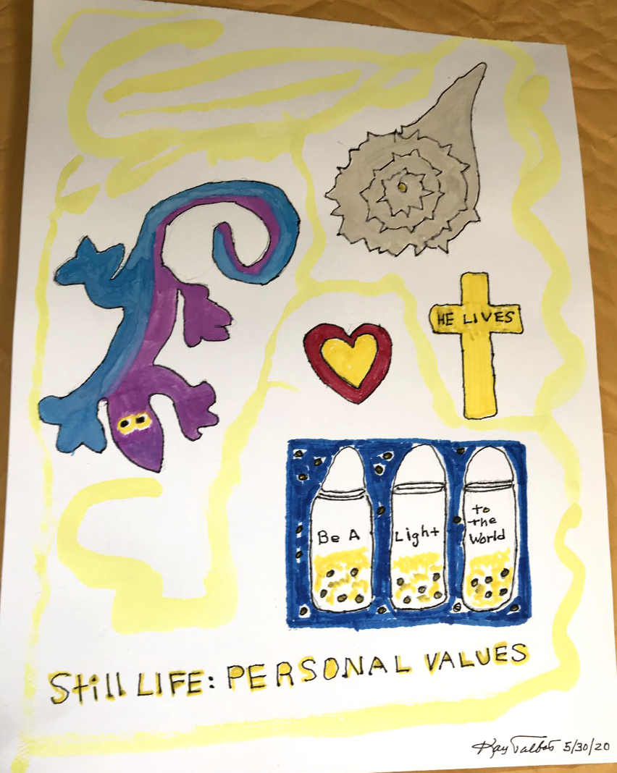
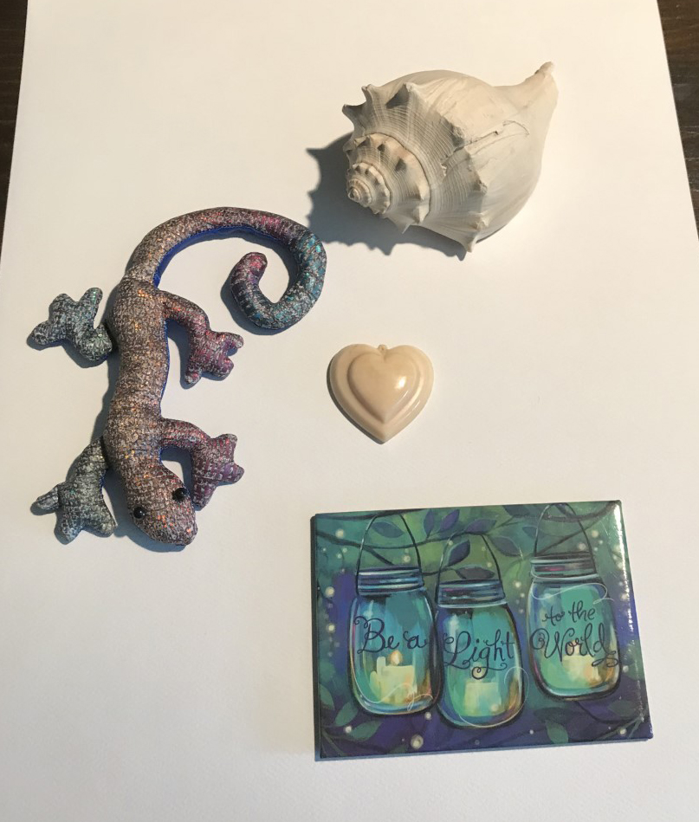
Recent Works
Kay

Slide 3
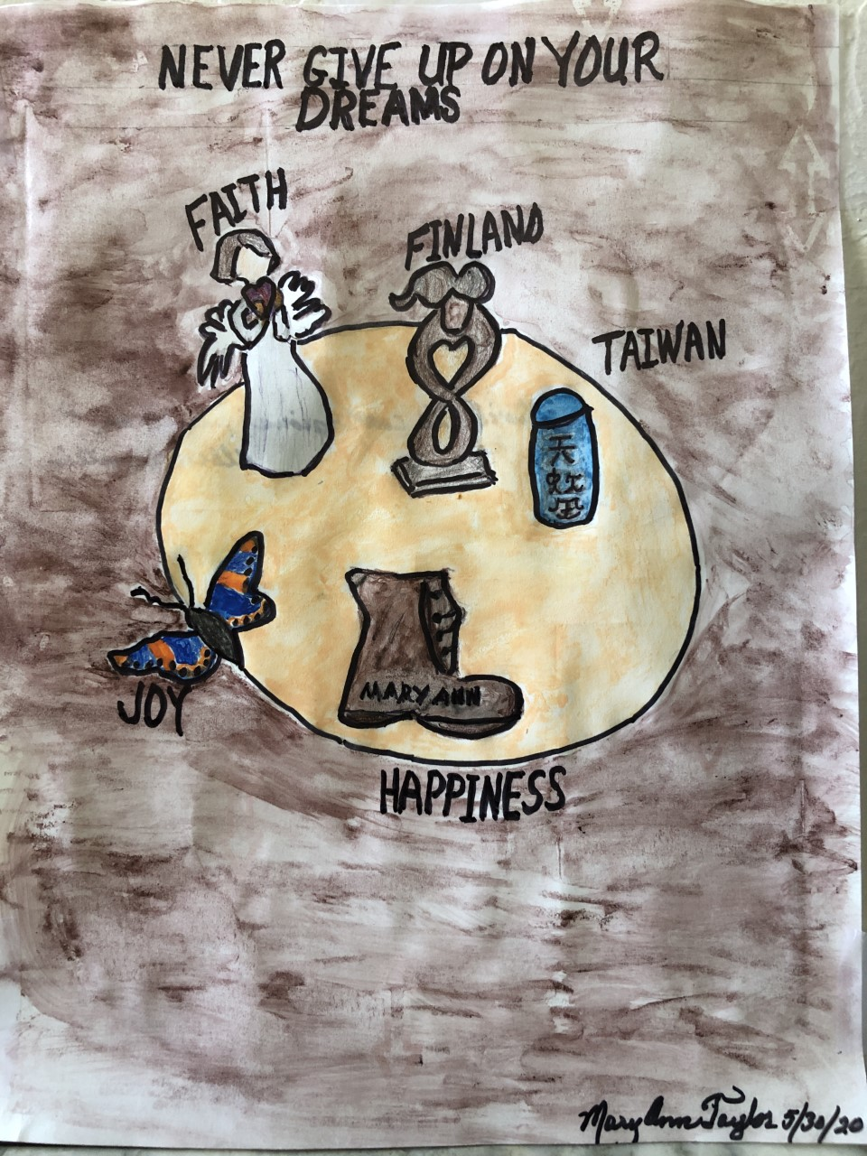
Recent Works
Mary Ann

Slide 4
Recent Works
Larry

Slide 5
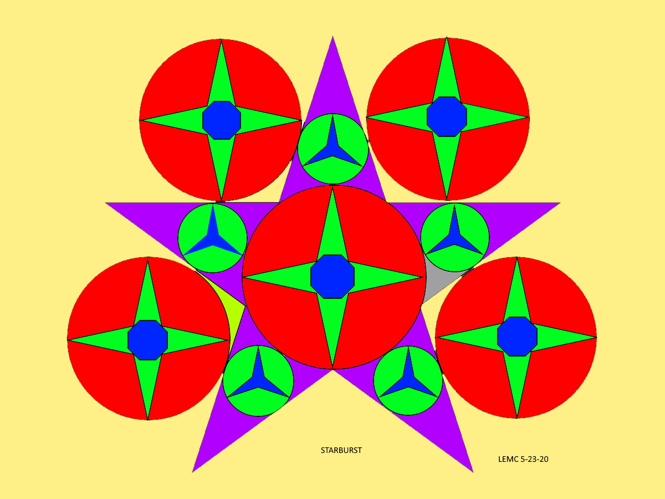
Recent Works
Larry

Slide 6
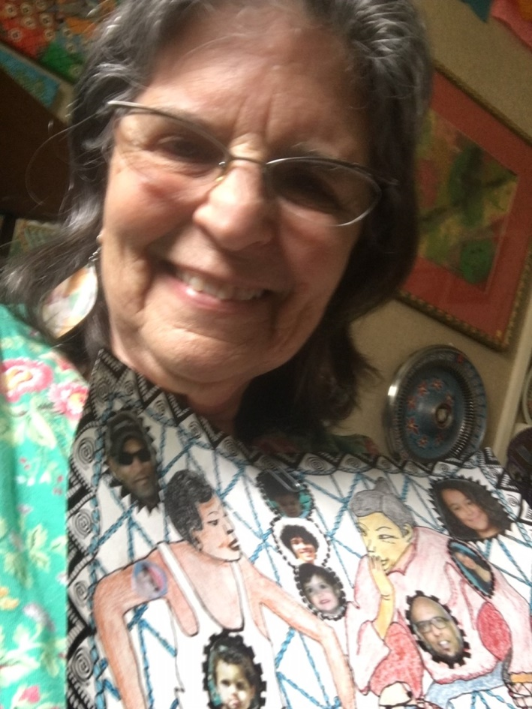
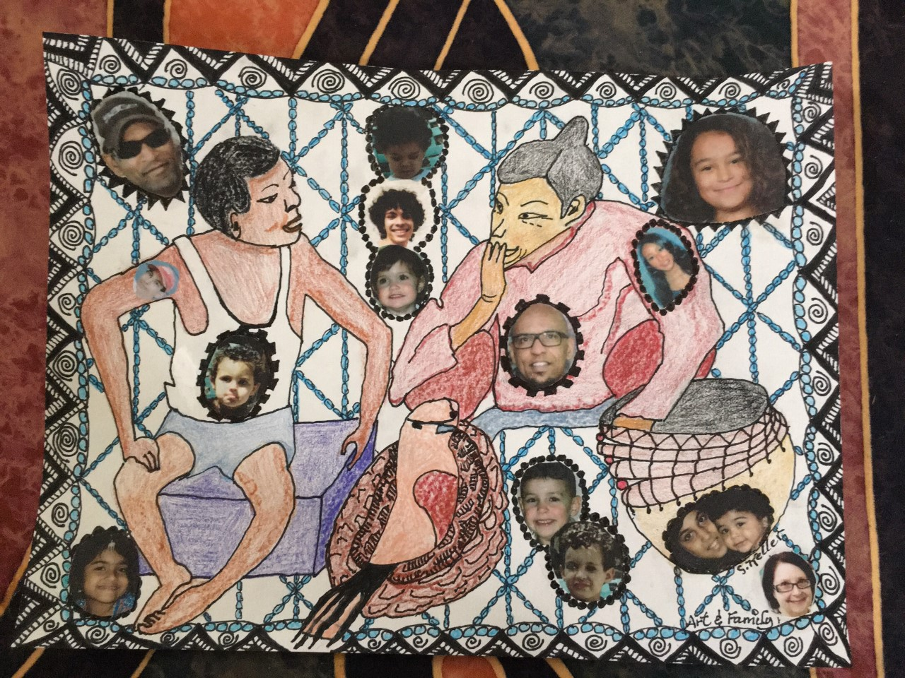
Recent Works
Shirley
Paula

Slide 7
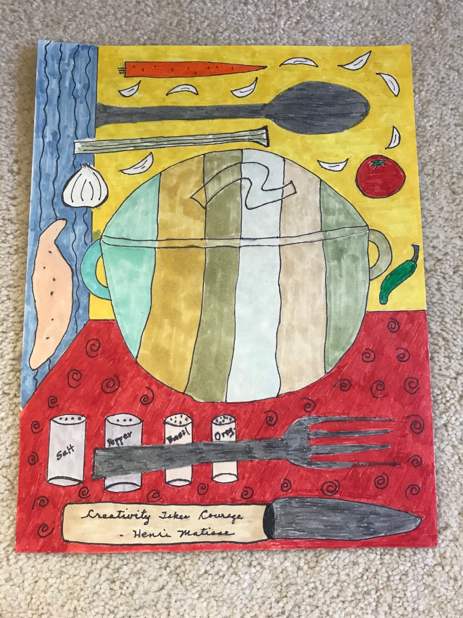
Recent Works
Fran

Slide 8
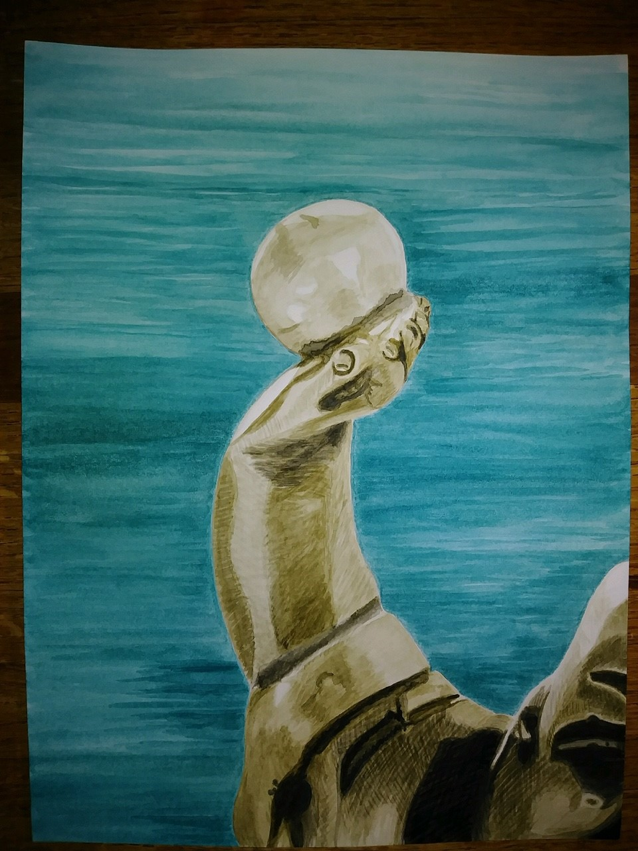
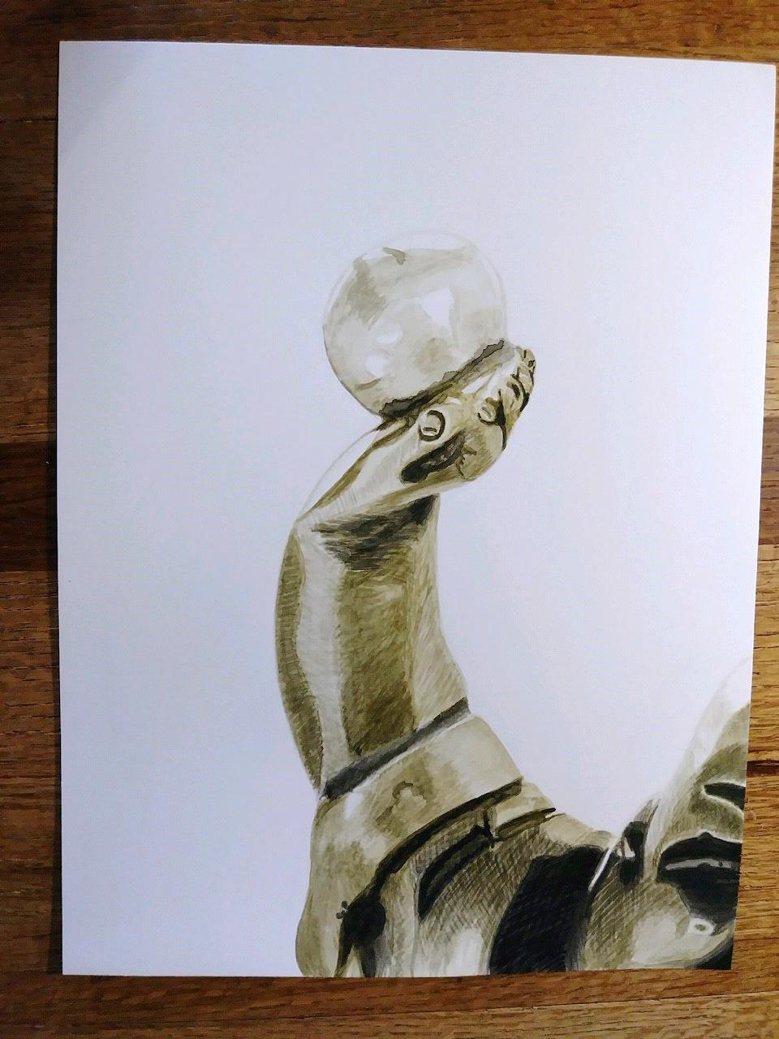
Recent Works
Melinda

Slide 9
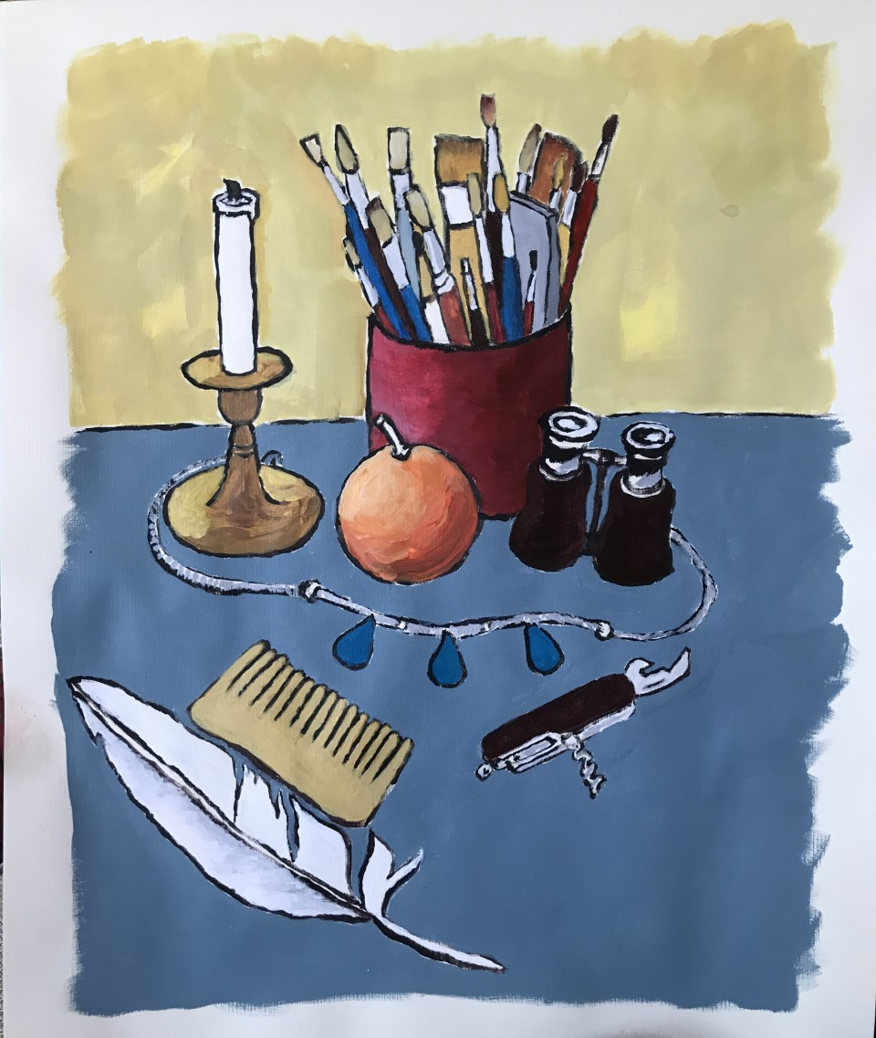
Recent Works
Darcie

Slide 10
Quotes
“It's one thing to make a picture of what a person looks like, it's another thing to make a portrait of who they are.” — Paul Caponigro
“All my images are self-portraits, even when I'm not in them.”
― Nuno Roque
“The reason some portraits don't look true to life is that some people make no effort to resemble their pictures.”
― Salvador Dalí
“A portrait is a painting in which there is something wrong with the mouth.” ― E. Speicher

Slide 11
Portraits: Drawing the Face
Prepare:
We will be learning the basics of drawing a face. You can use the image I have provided (attached), or you can supply your own image. If you can print out the images at the size you want for your drawing, that is best. We will just be using a pencil, eraser, and a ruler for this lesson.
Class time:
First, we will look at proportions of the face, then, discuss drawing using a grid, blind contour, and finally consider volume and shading. Drawing from my image or yours, we will try to capture a likeness of our source photo.

Slide 12
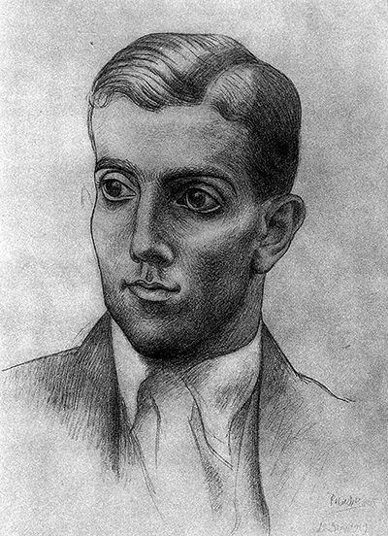
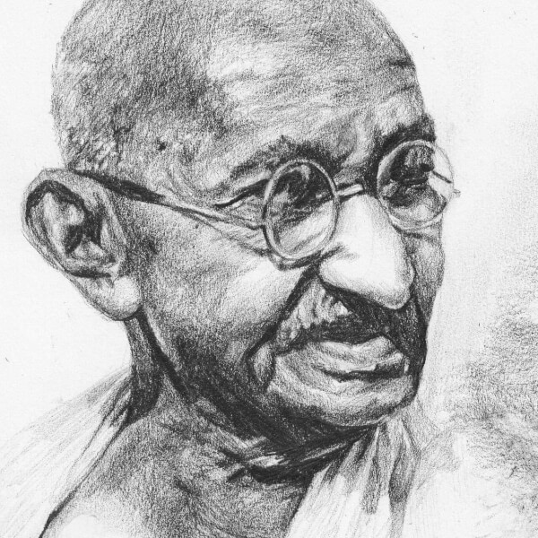
Inspiration

Slide 13
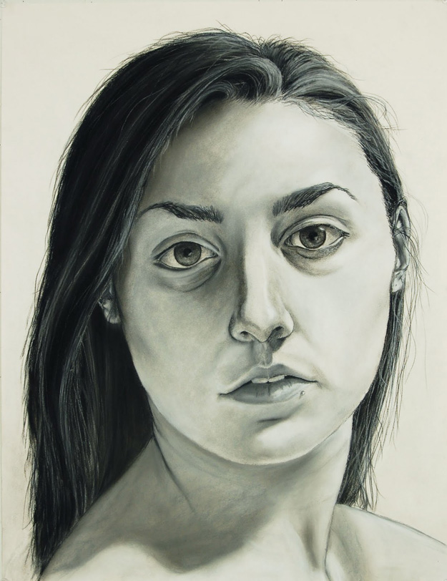
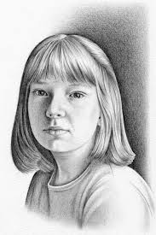
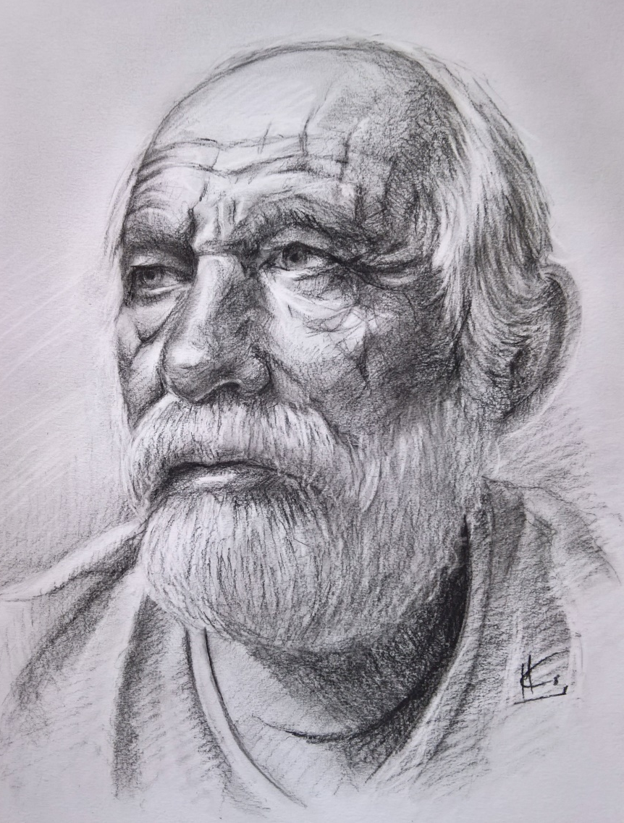
Inspiration

Slide 14
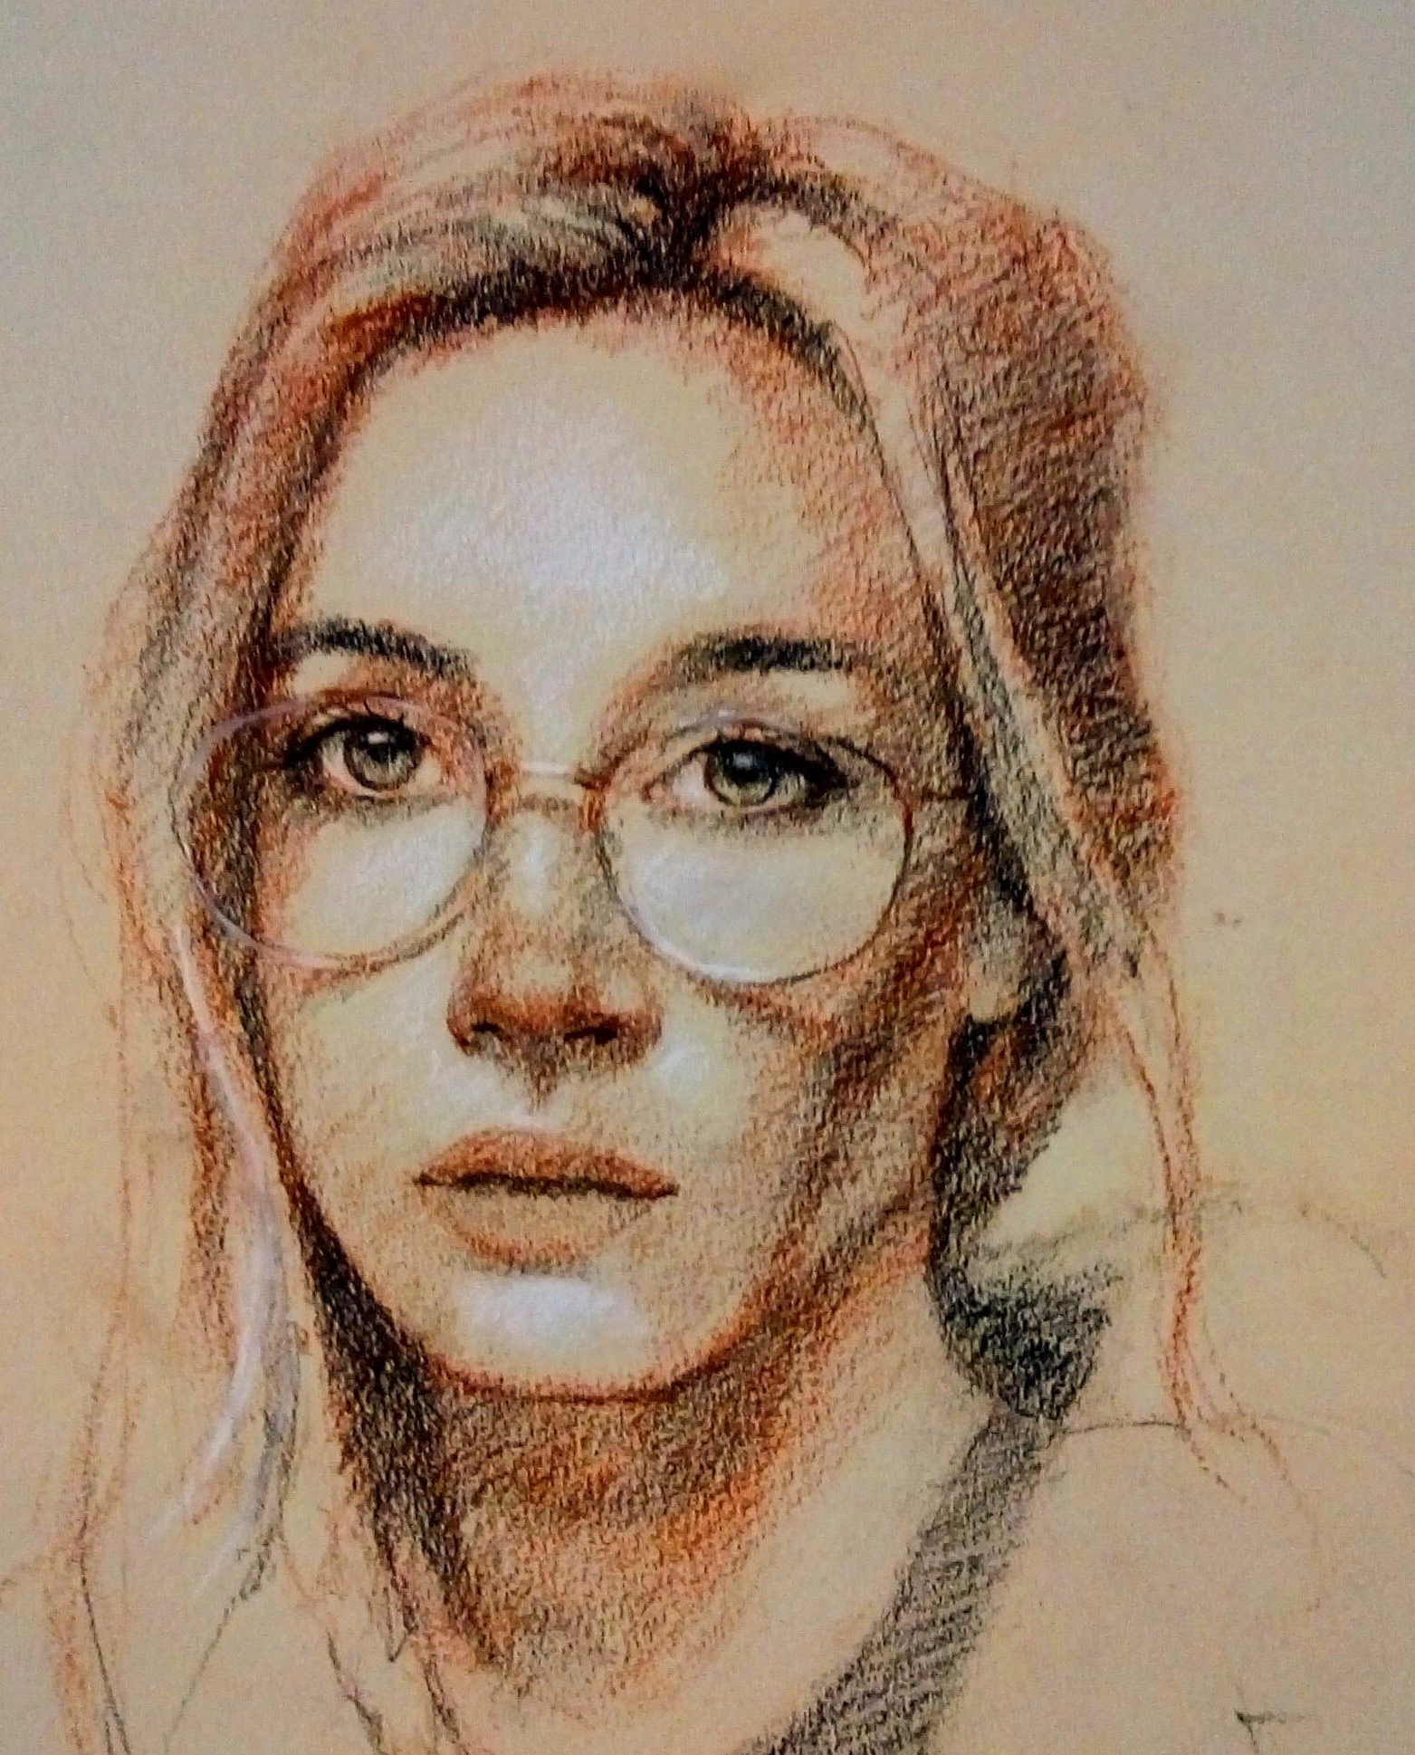
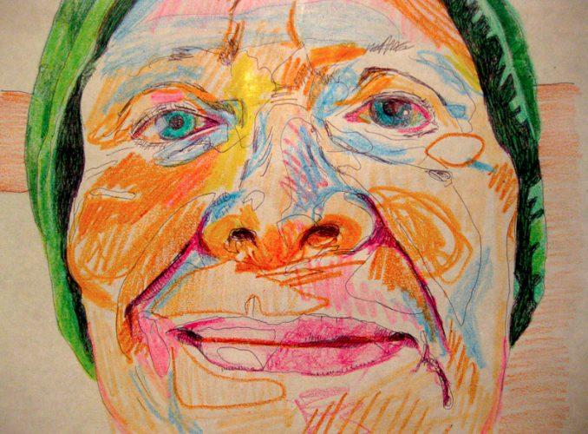
Inspiration

Slide 15
Inspiration – Florent Farges
https://www.youtube.com/watch?v=OxWNzQmg5Ac&t=639s

Slide 16
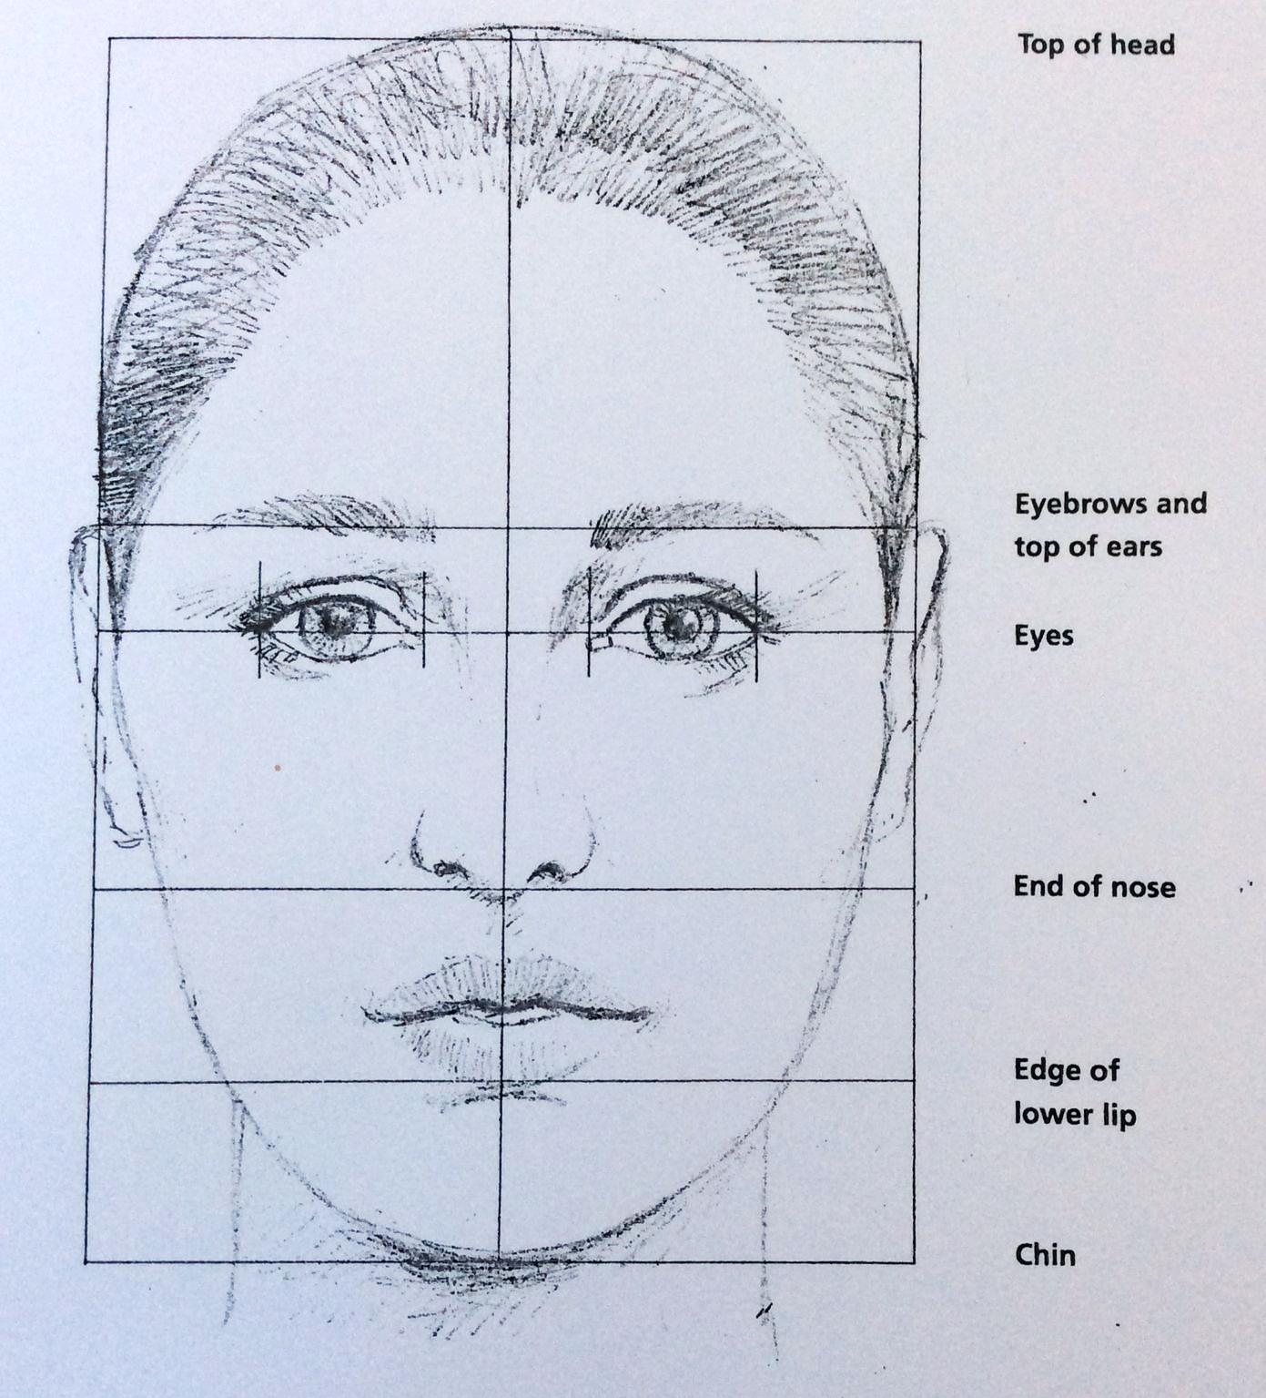
Drawing the Face - Proportions

Slide 17
Drawing the Face - Proportions

Slide 18
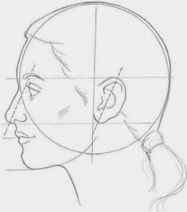
Drawing the Face - Proportions

Slide 19
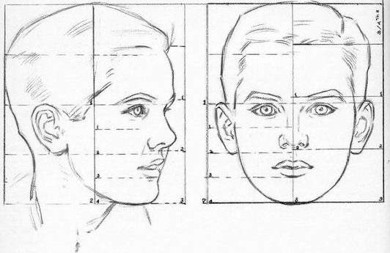
Drawing the Face - Proportions

Slide 20
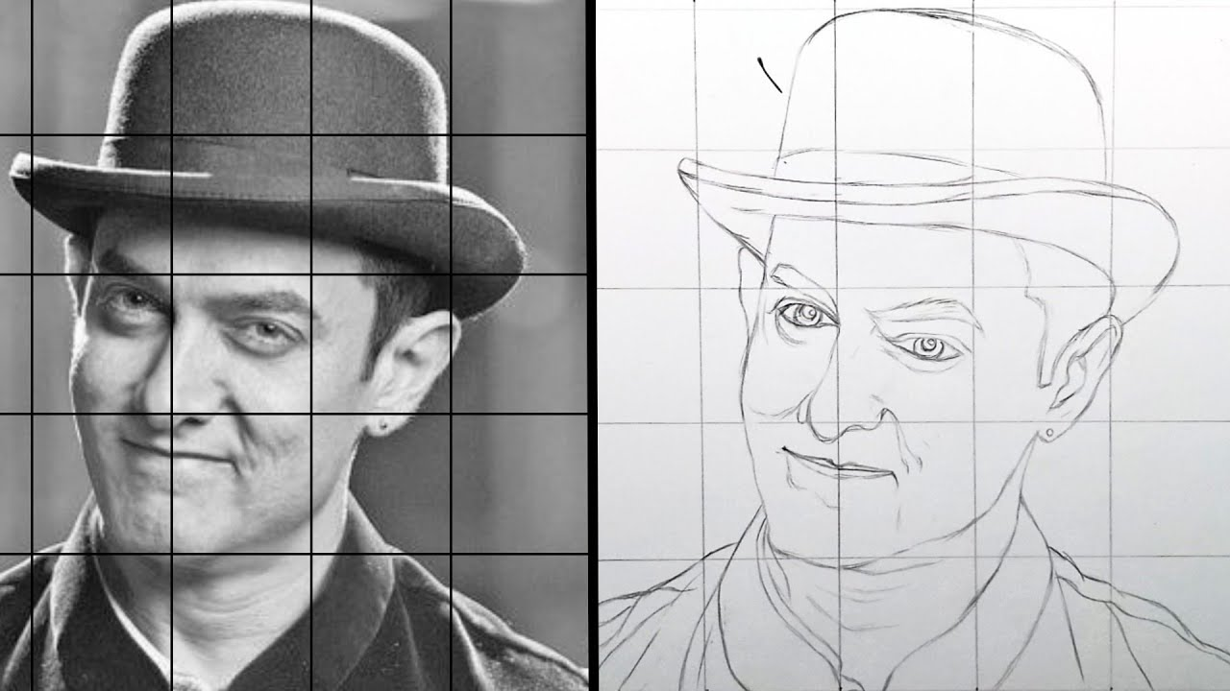
Drawing the Face – Grid Lines

Slide 21
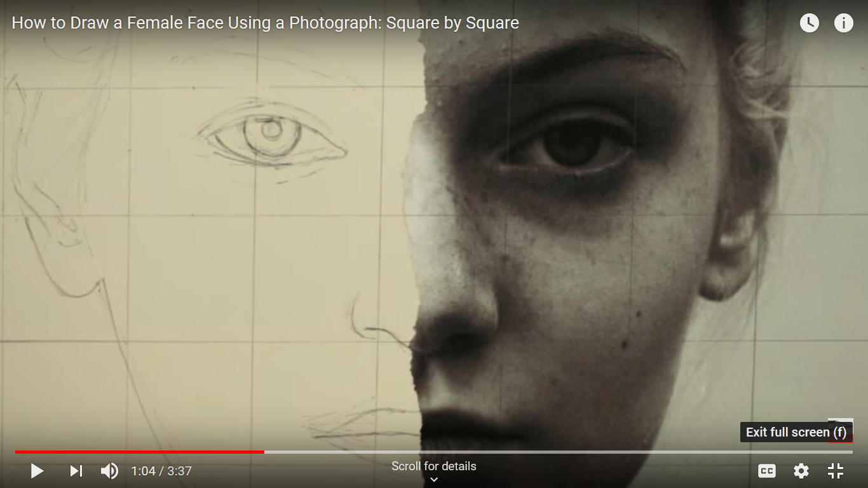
Drawing the Face – Circle Line Art School
https://www.youtube.com/watch?v=f1ElsMqE8uE

Slide 22
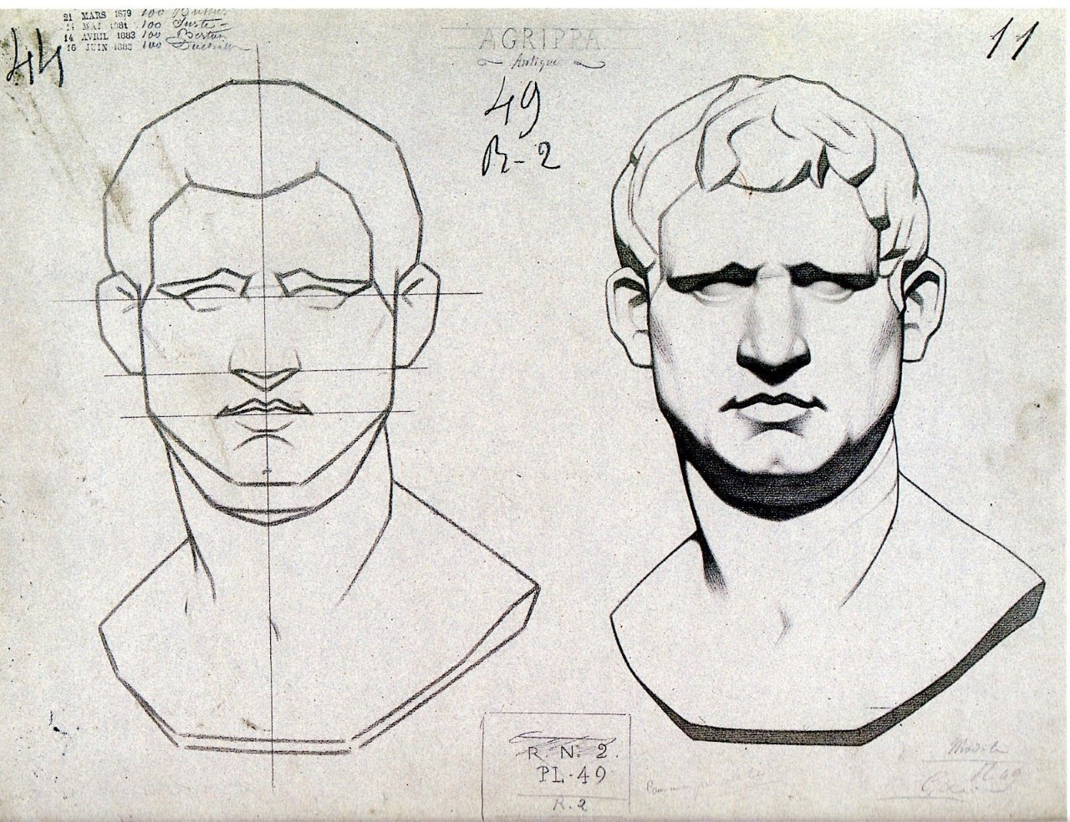
Drawing the Face – Proportion and Shading

Slide 23
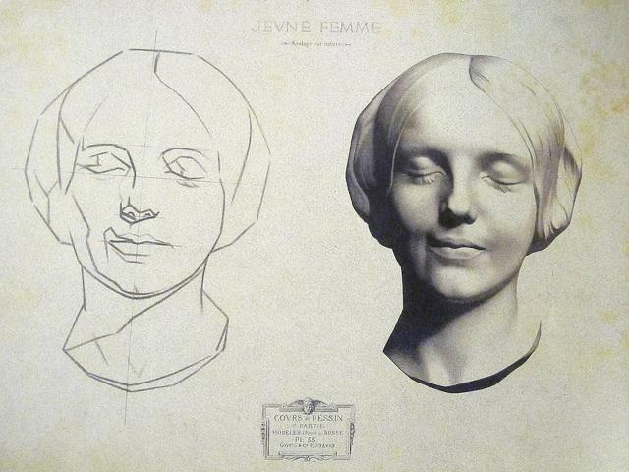
Drawing the Face – Shading

Slide 24
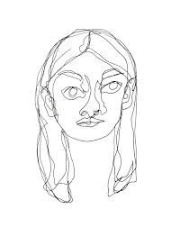
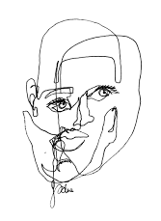
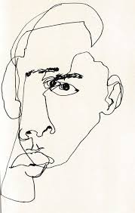
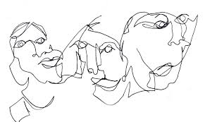
Drawing the Face – Blind Contour – Draw without looking at your paper

Slide 25
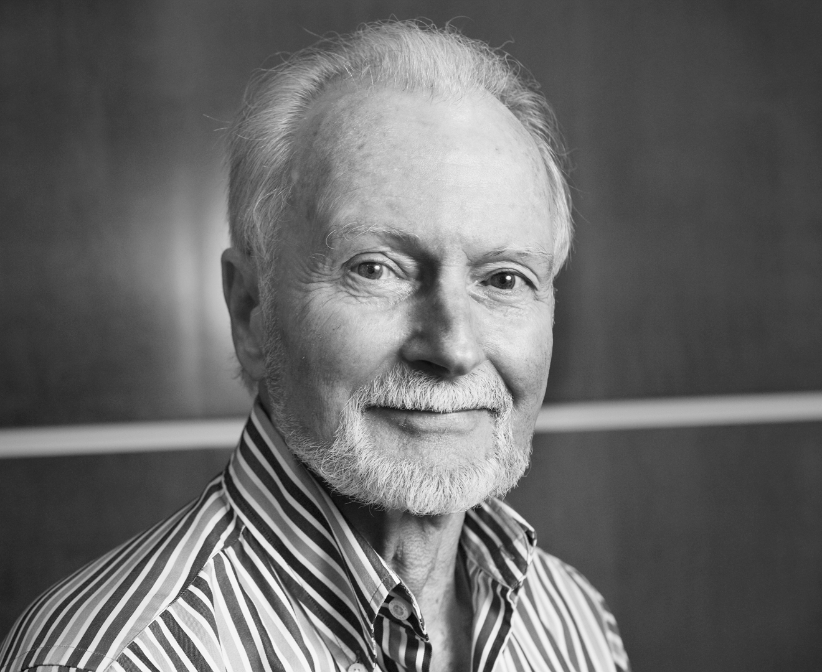
Source Material AWE Program Artist Richard Williams – Photo by Guy Poole

Slide 26
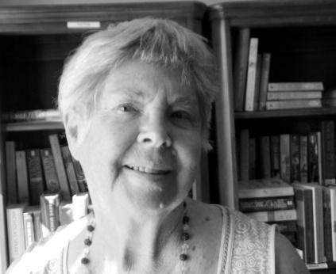
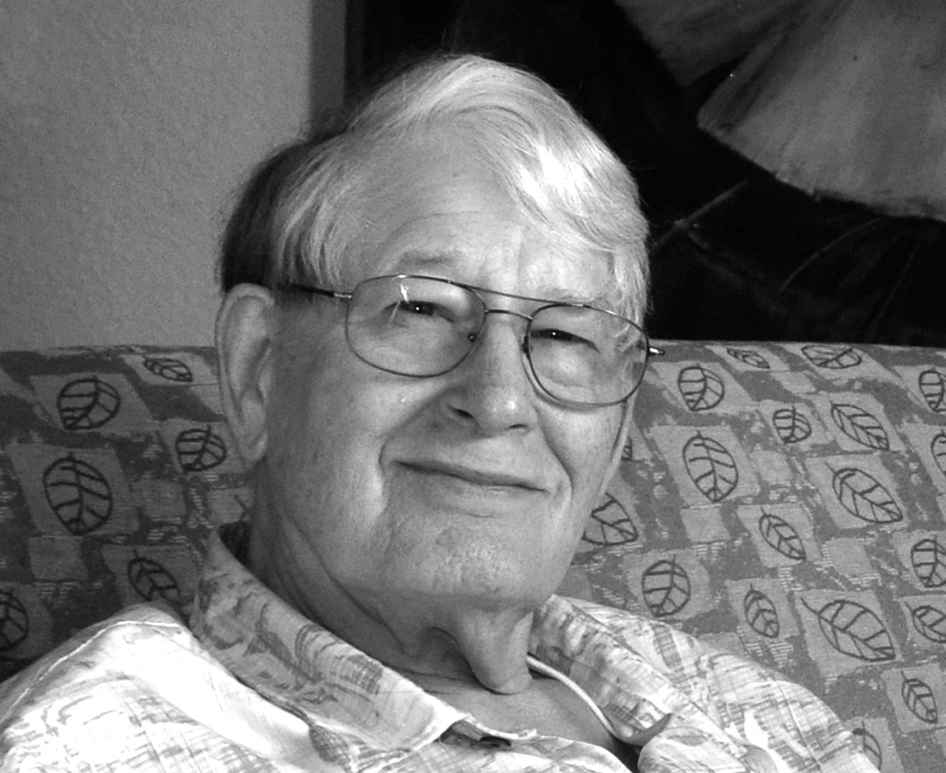
Art With Elders
AWEsome Art www.artwithelders.org
Exhibitions
Take the best photo of your work that you can.
Take a pic of you with your work.
Send me a photo of yourself that will represent you with your work, head and shoulders.
Create a brief biography and/or artist’s statement.
For example: Susan has been an enthusiastic part of the AWE class and exhibits over the last several years. She is experienced in pottery, but has embraced art making through drawing, watercolor, and acrylics in the AWE art class. She is a resident of our partner community, Vallejo Hills.
I will send you a release form to sign that says you agree to have your art and pictures exhibited to the public.
Demographics for Grant Funders
Age, Race/Ethnicity, Disability

Slide 27
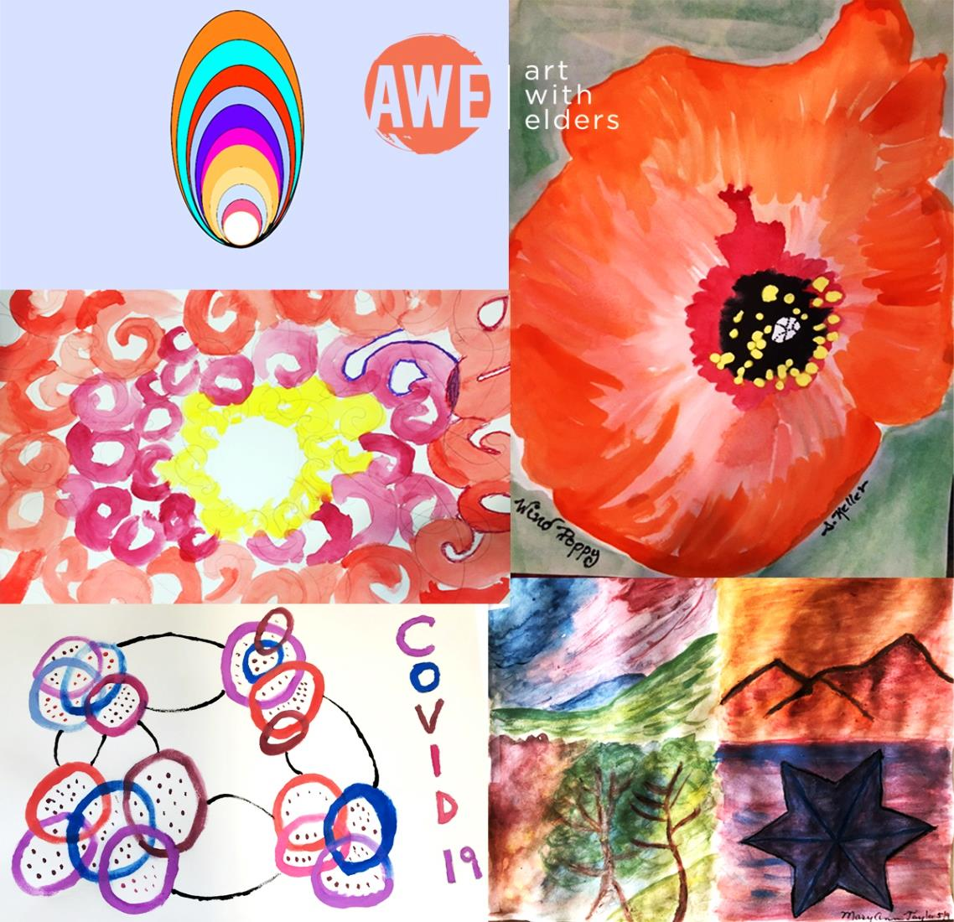
Art With Elders
AWEsome Art www.artwithelders.org
I hope you will enjoy and find value in our session. Your support helps keep our program and our artist instructors going. If you are able to give a donation for this class, we would greatly appreciate it. Thank you!
Donations may be made on our website at: www.artwithelders.org
Or by check, mail to:
Art With Elders
236 West Portal Ave. #845
San Francisco, CA 94131

