Slide 1
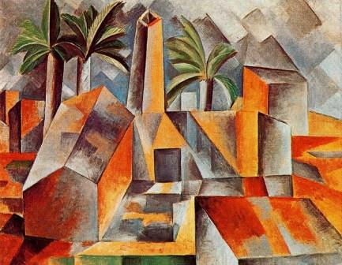
Art With Elders
AWEsome Art with Darcie www.artwithelders.org
Artists Choice

Slide 2
Artists Choice
Prepare:
Think of a project idea for yourself. Work with a theme, subject, and or materials that call to you.
Class time:
For this week, we will create our own project. Create a drawing, painting, or collage based on a theme or subject of your own choosing. Work with any medium or combination of media that you prefer.

Slide 3
Quotes
“Painting is self-discovery. Every good artist paints what he is.” Jackson Pollock
“An artist cannot fail; it is a success to be one.”
Charles Cooley
“To draw you must close your eyes and sing.”
Pablo Picasso
“The world always seems brighter when you’ve just made something that wasn’t there before.” Neil Gaiman

Slide 4
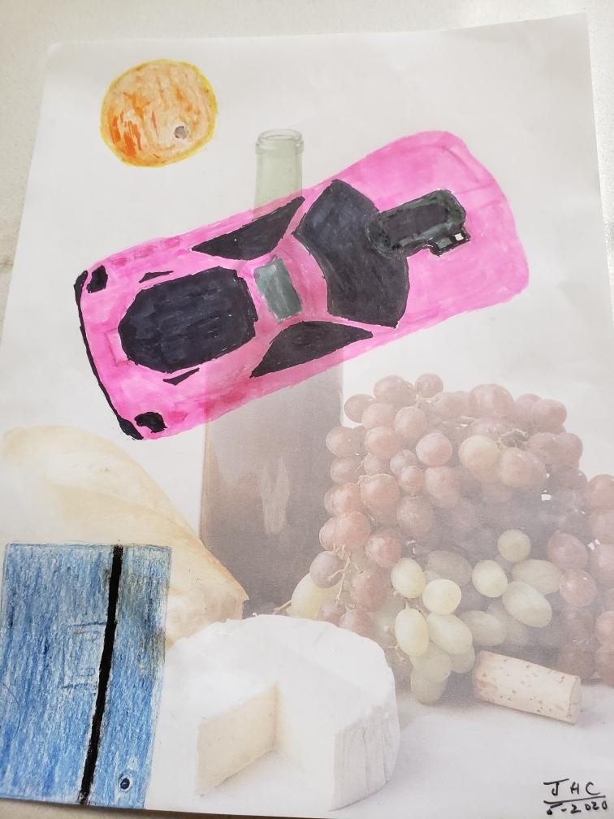
Recent Works
John

Slide 5
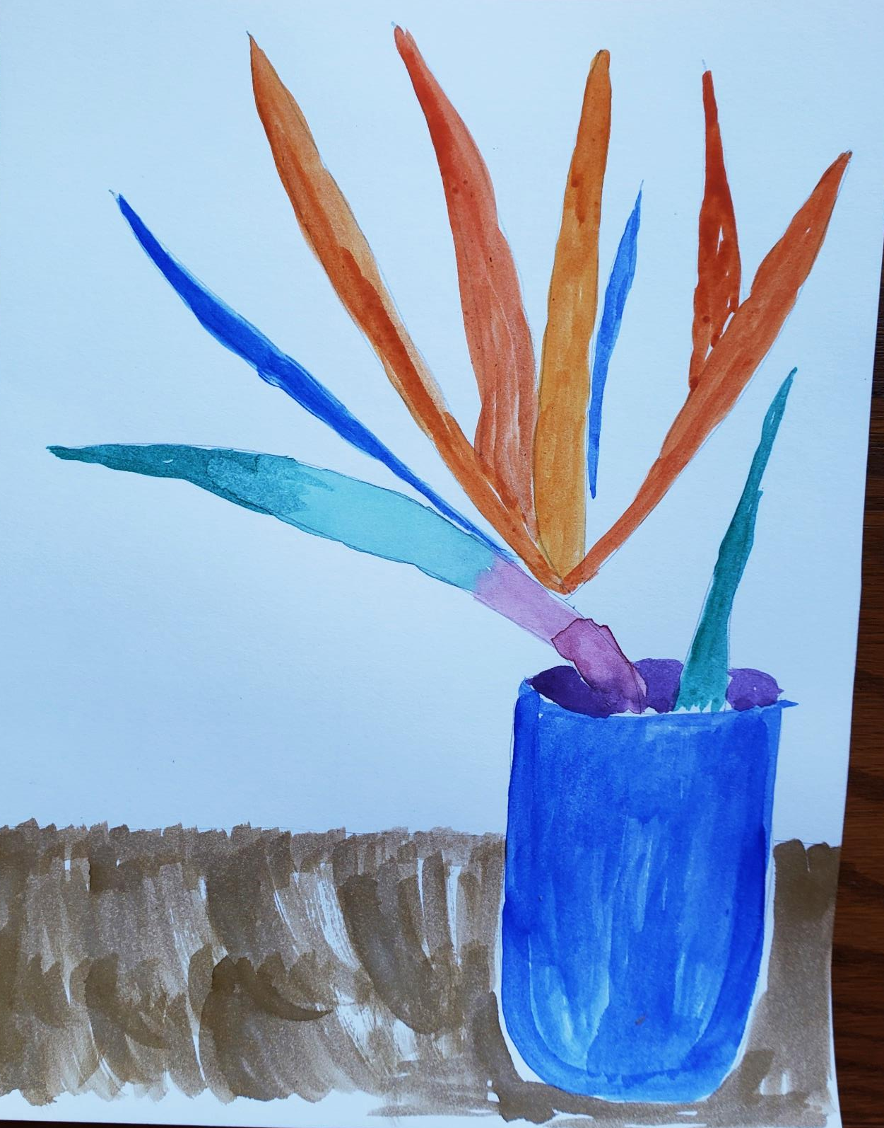
Recent Works
Sandra

Slide 6
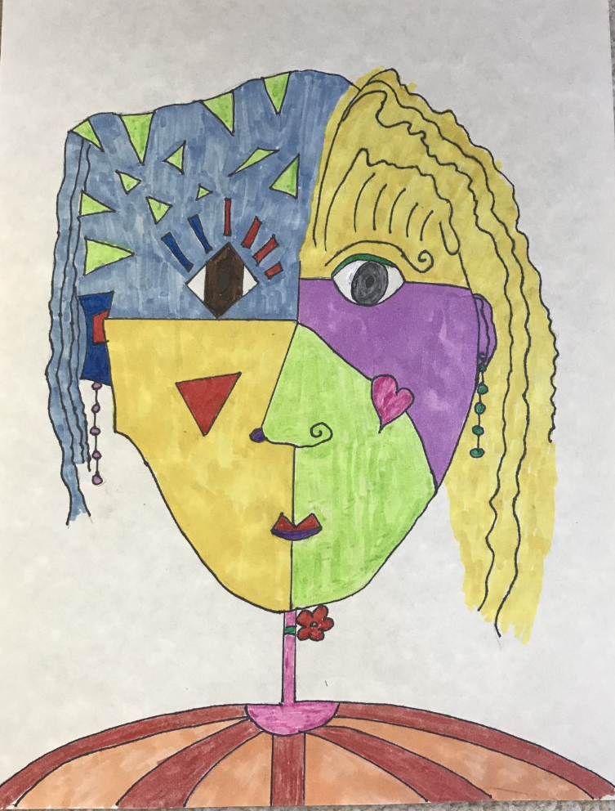
Recent Works
Fran

Slide 7
Recent Works
Fran

Slide 8
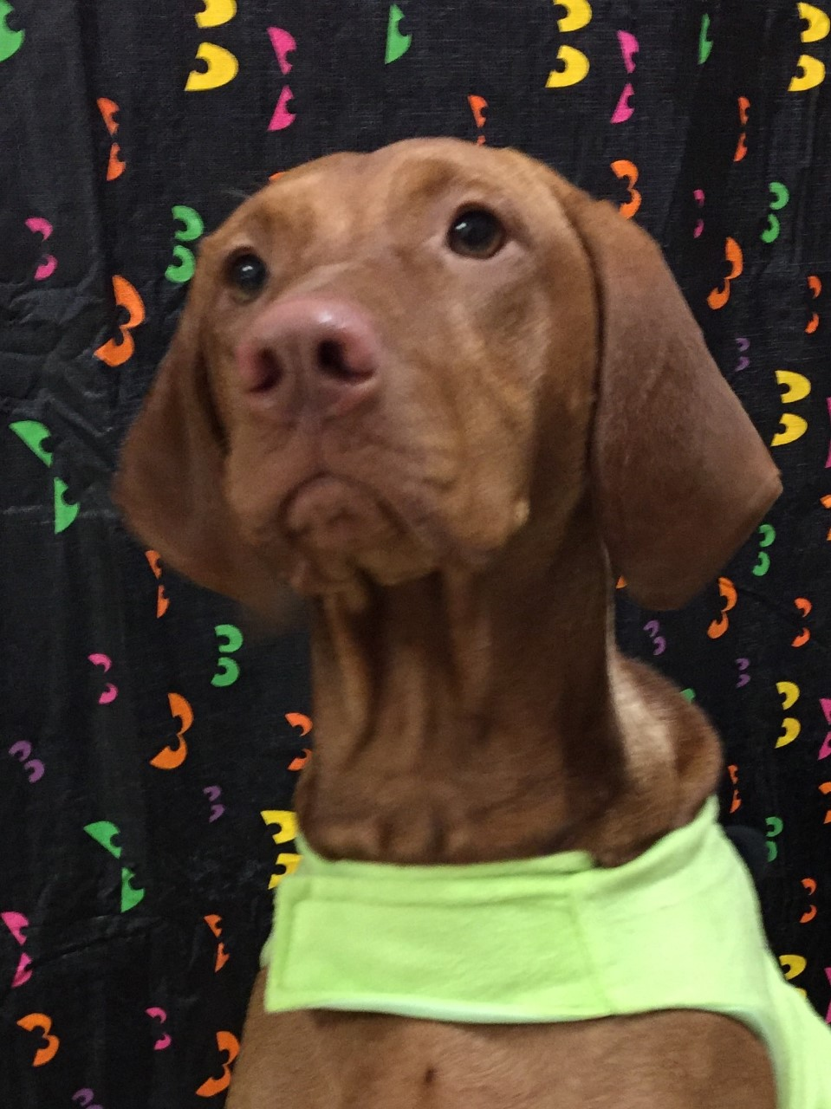
Recent Works
Kay

Slide 9
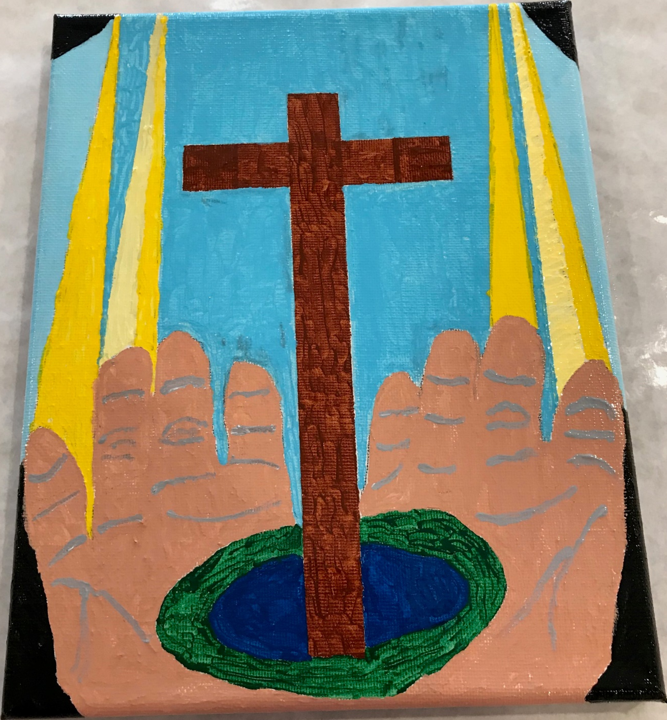
Recent Works
“Receiving the gift “. The cross represents the love of Christ and His gift of resurrection. The two shades of yellow represent God’s grace and mercy. The blue = Earth’s oceans. The green = Earth’s plants. The black = our vulnerability to sin and death.
Kay

Slide 10
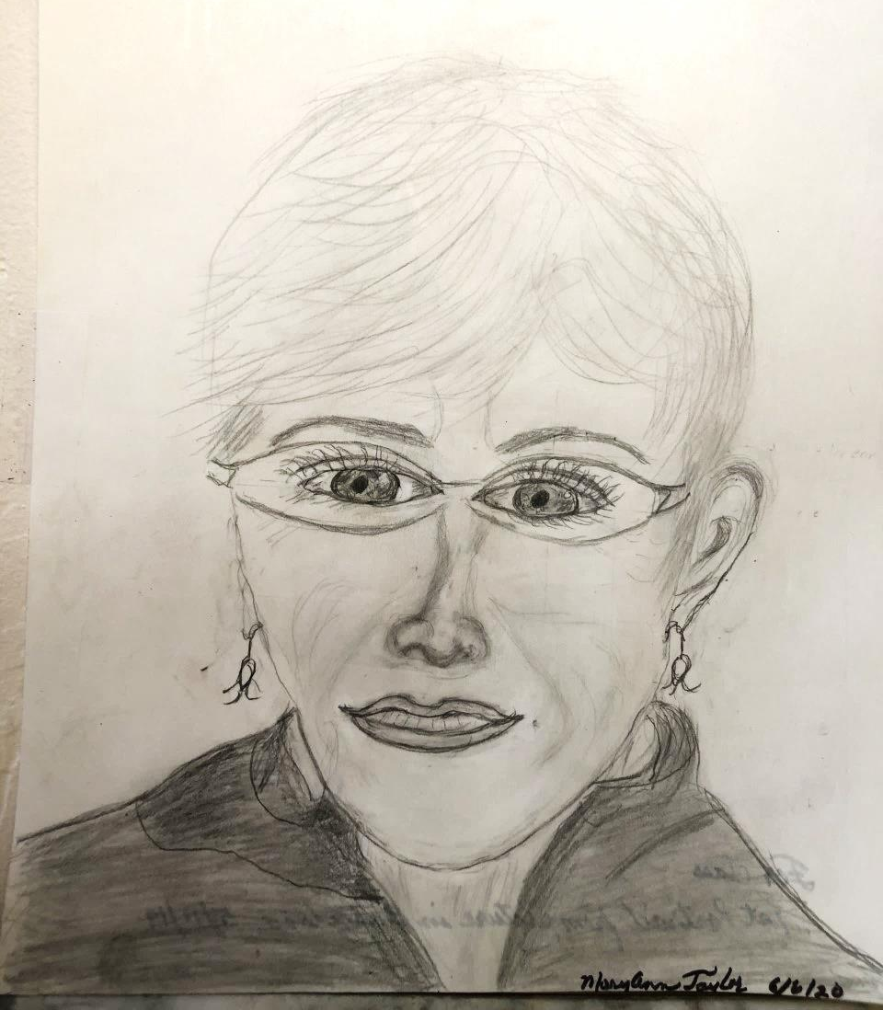
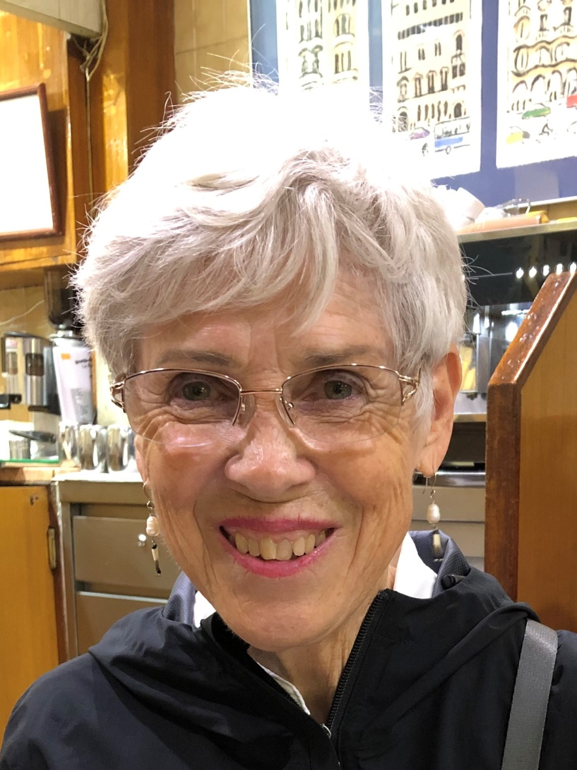
Recent Works
Mary Ann

Slide 11
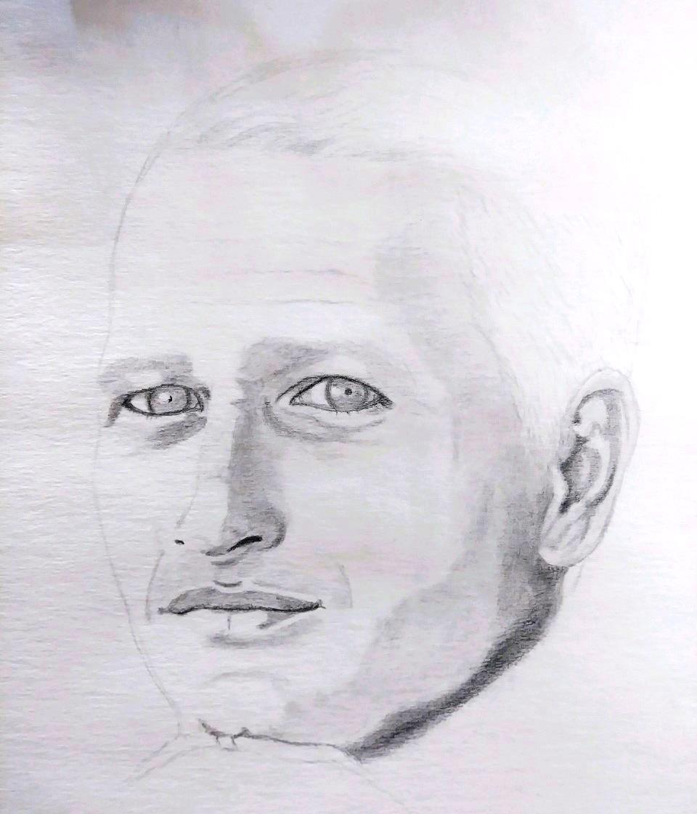
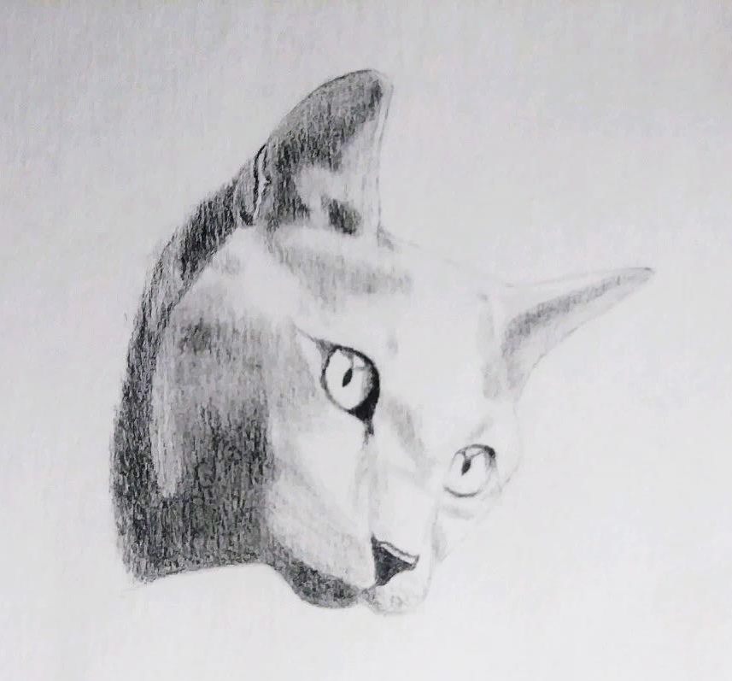
Recent Works
Melinda

Slide 12
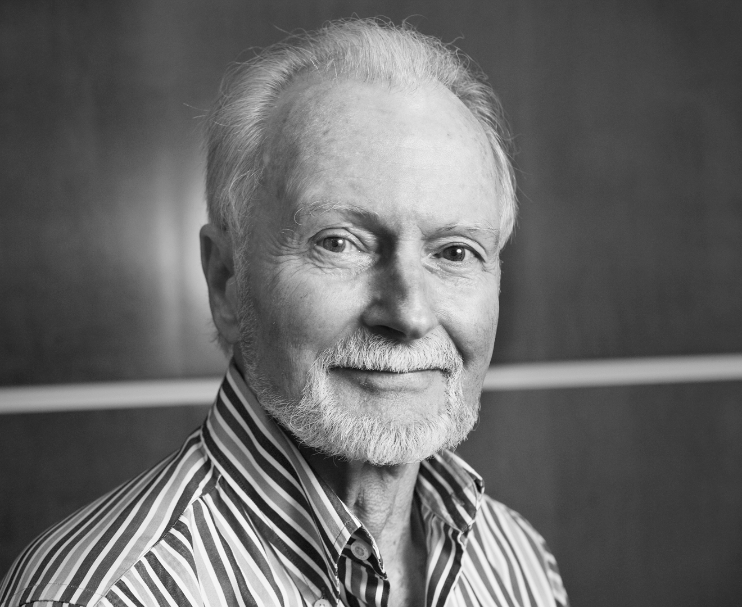
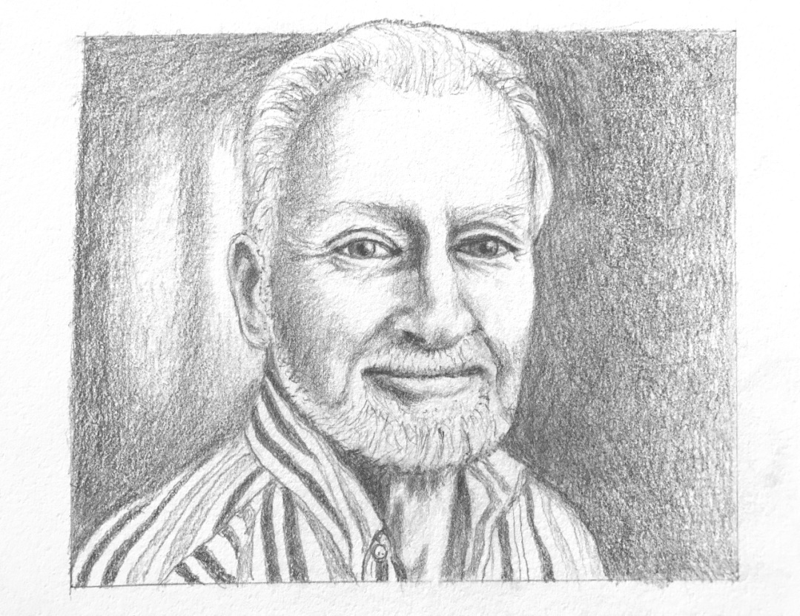
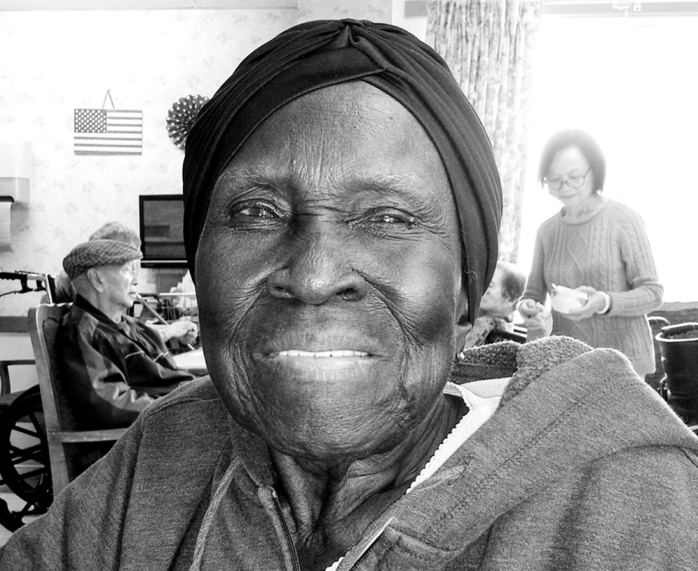
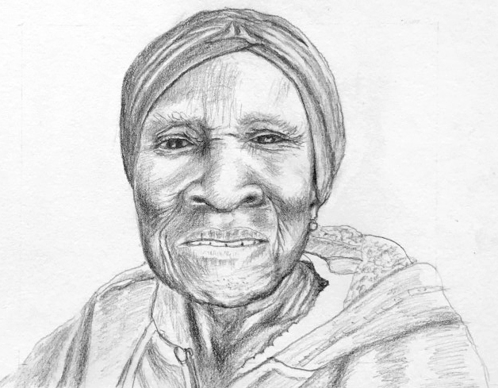
Recent Works
Darcie

Slide 13
Art With Elders
AWEsome Art www.artwithelders.org
Exhibitions AWE’s First Online Exhibit - Date changed : 7/15-9/15
Give your piece a title.
Send me a photo of yourself that will represent you with your work, head and shoulders.
Create a brief biography and/or artist’s statement.
Send me a quote, your feeling about art and/or our class.
I will send you a release form to sign that says you agree to have your art and pictures exhibited to the public.

Slide 14
Releases Received
Kay
Fran
Shirley
Mary Ann
Hope to Receive
Larry Susan Paula John Sandra
Melinda Pamela Jim
Georgia Insio Chelsea Betty?

Slide 15
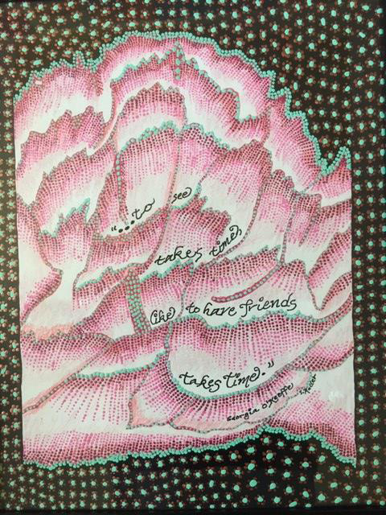
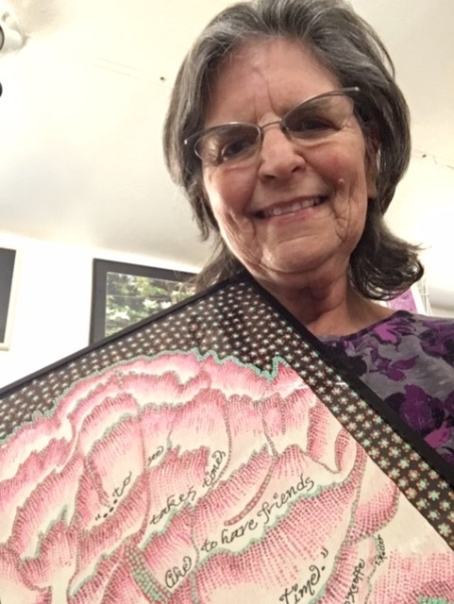
Shirley
Spirit Hill Meditation Garden and Art Studio, in Three Rivers, is Keller’s favorite place to be, letting the creative energies have the day. Keller plays with clay, focusing on ceramic masks. Repurposed items like hubcaps, skill saws, horseshoes, and more, are made into art pieces with dots of acrylic. Mixing words and art is her latest exploration on canvas and hubcaps. Gift Cards Keller designs from her photography. Keller’s art work grew out of her love of writing, which she does every morning. Coordinator for 1st Saturday in Three Rivers, a monthly art event.
Published in two books: But What About The Children? Diversity is Life: A Memoir, 2019, by Shirley A. Blair Keller Amazon in paperback and Kindle; Tulare-Kings Writers Present Tales From The Strip Mall, An Anthology of Short Stories available on Amazon. Edited by Judith Bixby Boling, 2020

Slide 16
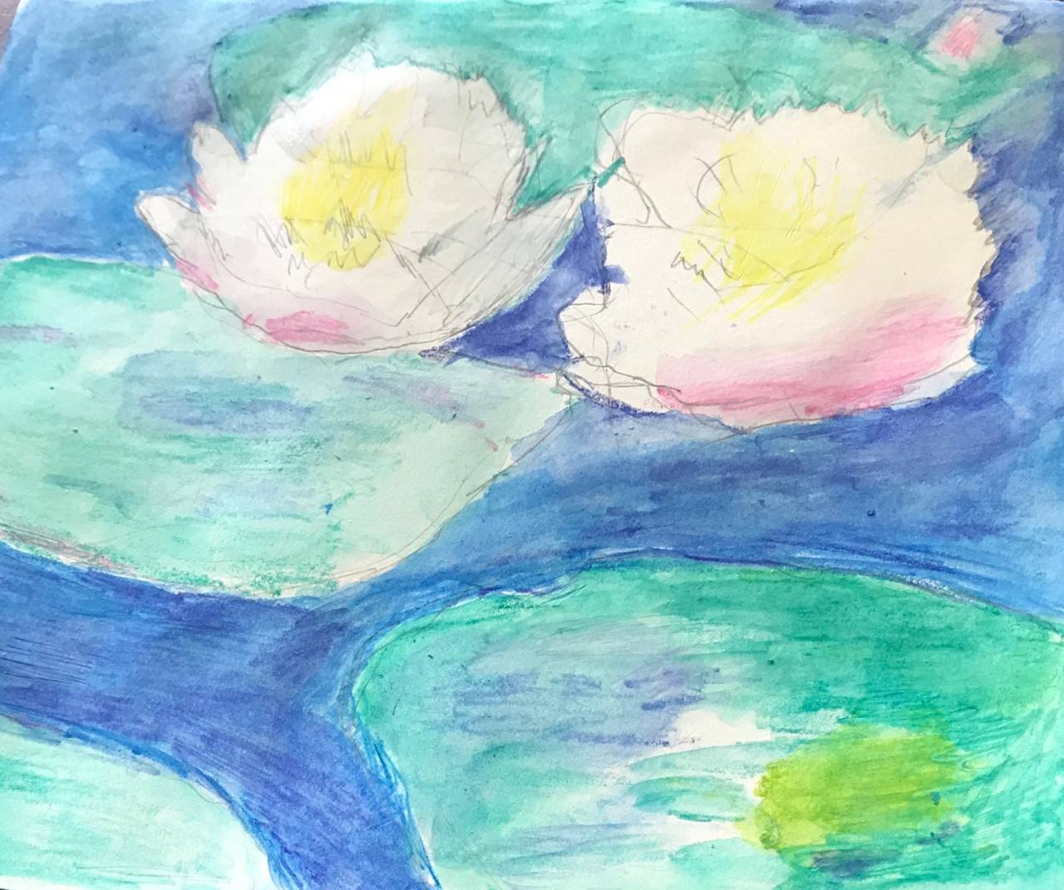
Online Exhibit
Paula

Slide 17
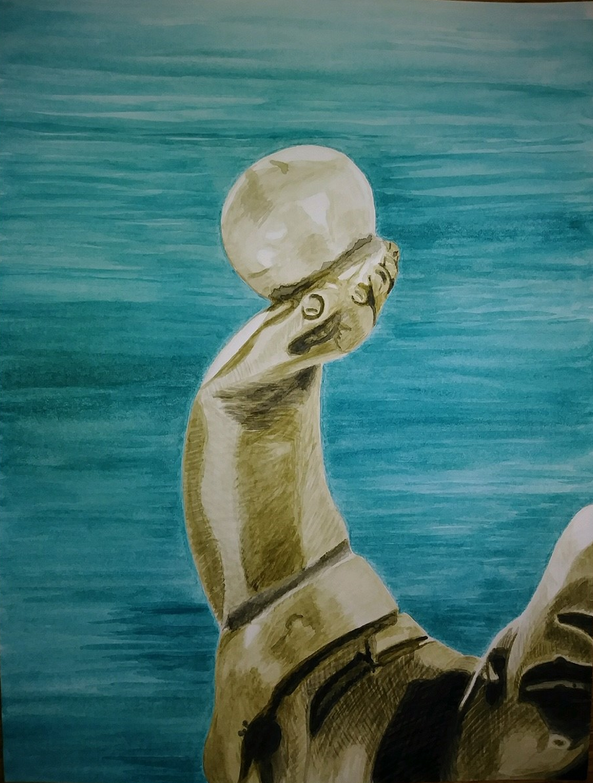
Online Exhibit
Melinda

Slide 18
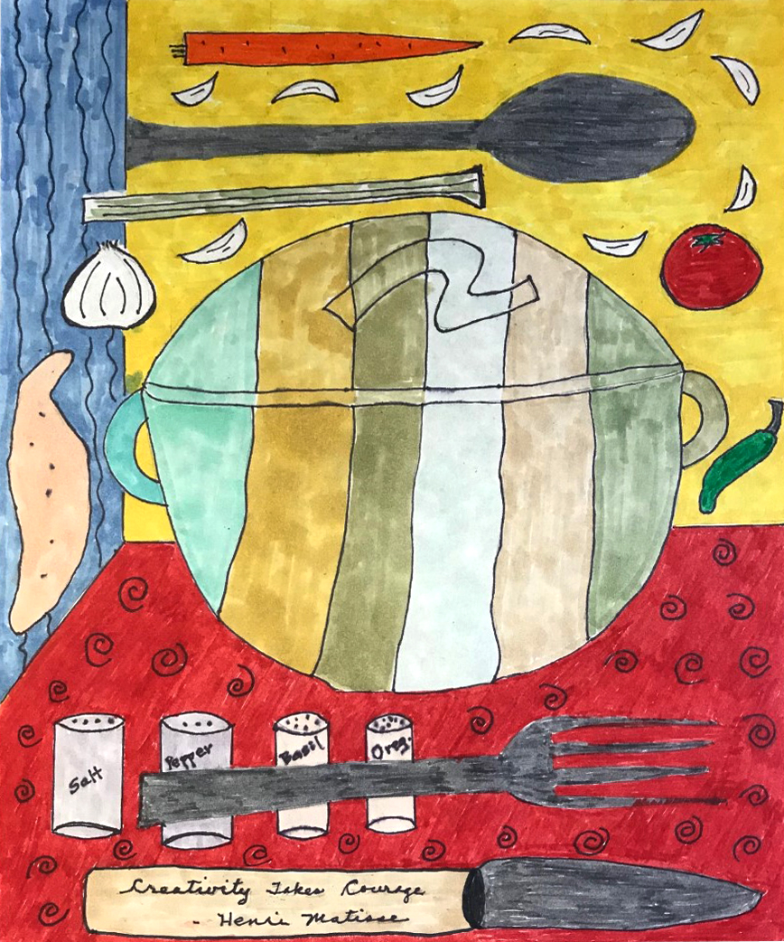
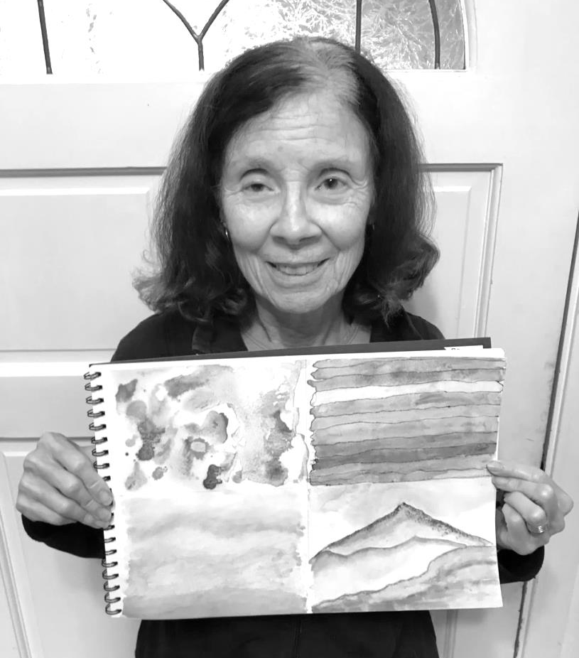
Online Exhibit
Fran
Fran

Slide 19
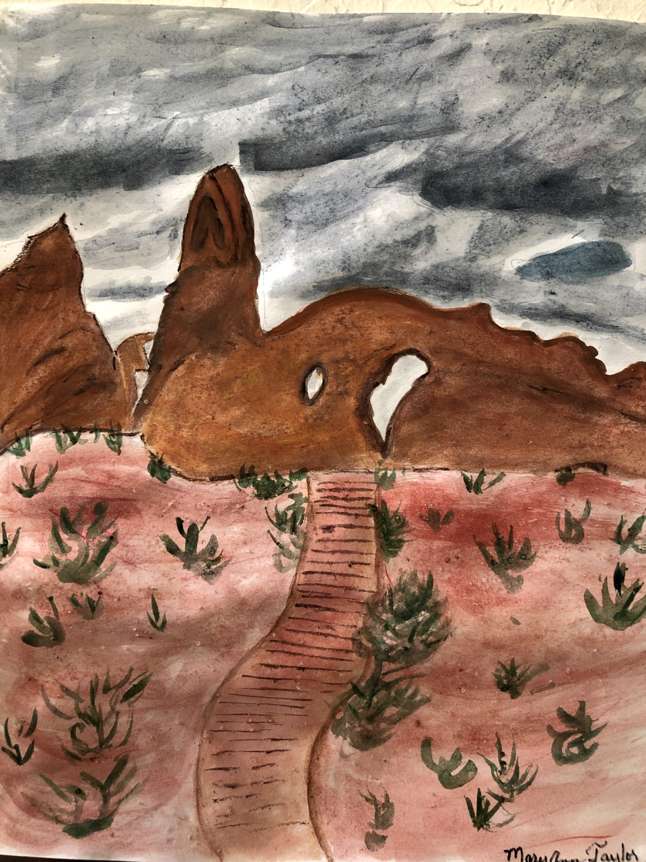
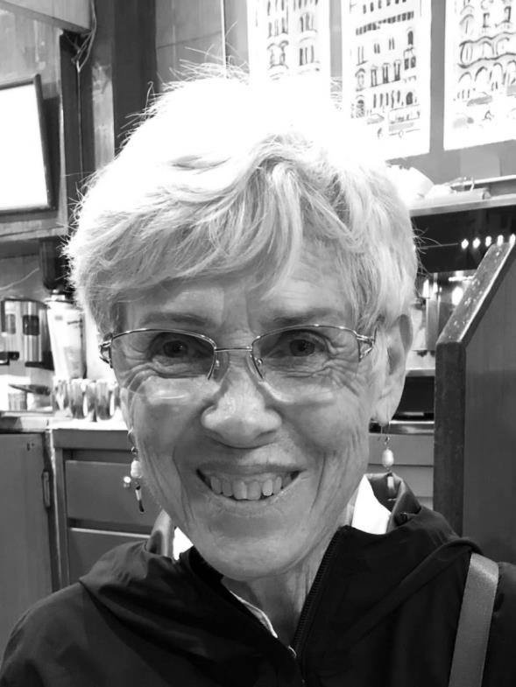
Online Exhibit
Mary Ann
I am a retired elementary teachers. I taught all grades during my career. My favorite grade was 5th grade, because of the students interest and the curriculum. I taught in Finland and a Taiwan. Loved the cultural experience and making lasting friends. I love AWE’s , since I never had time to take art classes in my past, but I am enjoying it in retirement.

Slide 20
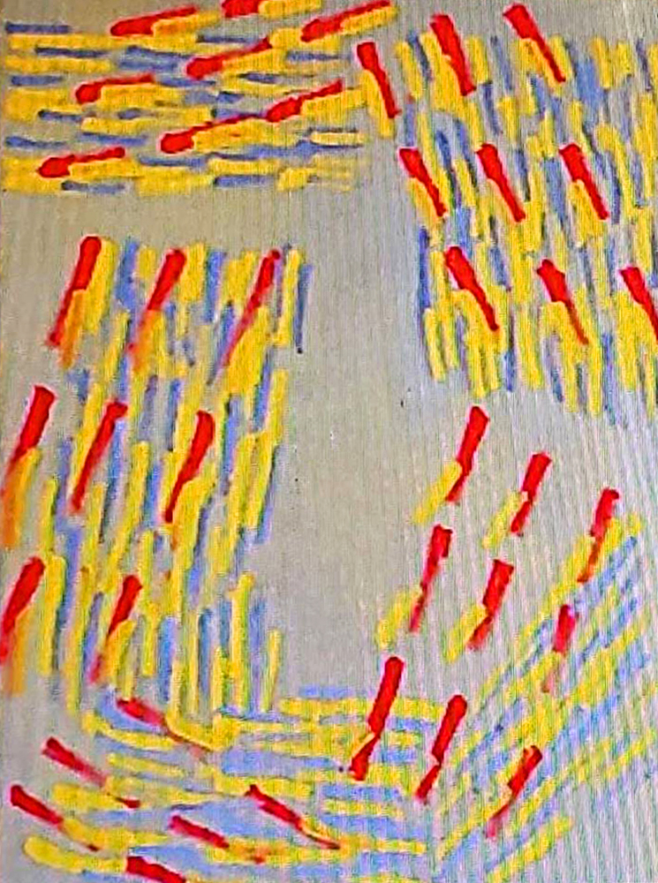
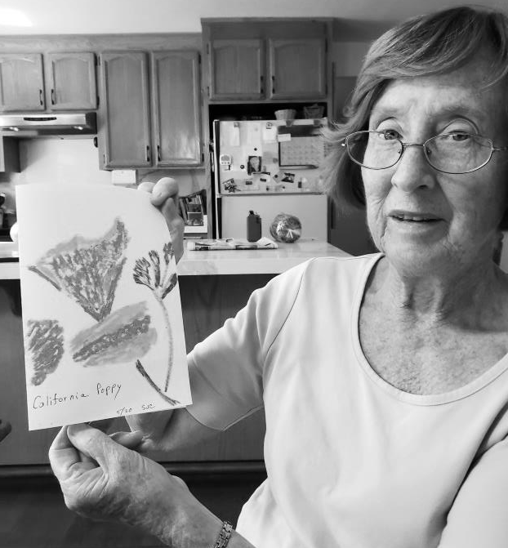
Online Exhibit
Sandra

Slide 21
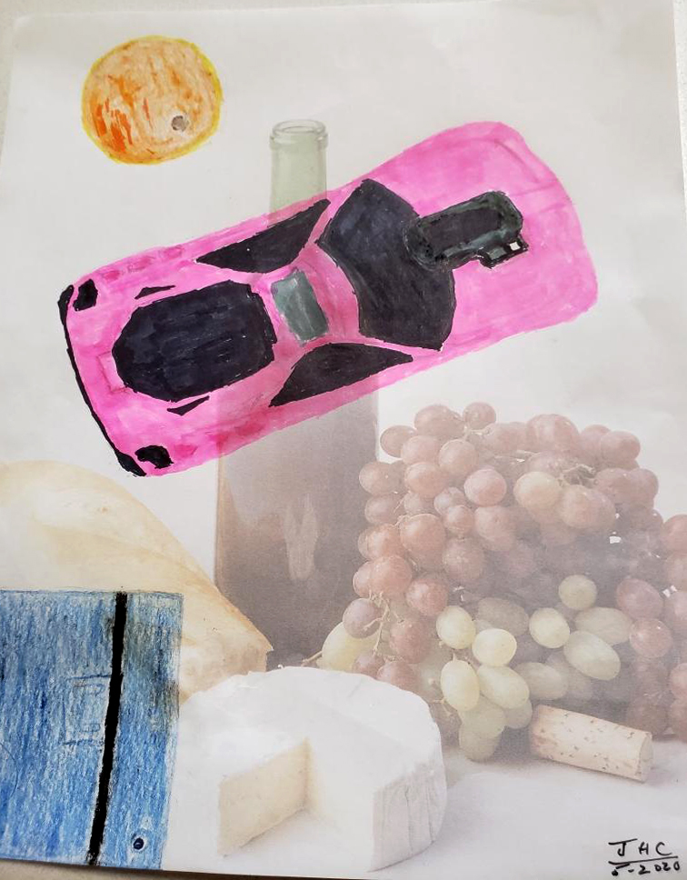
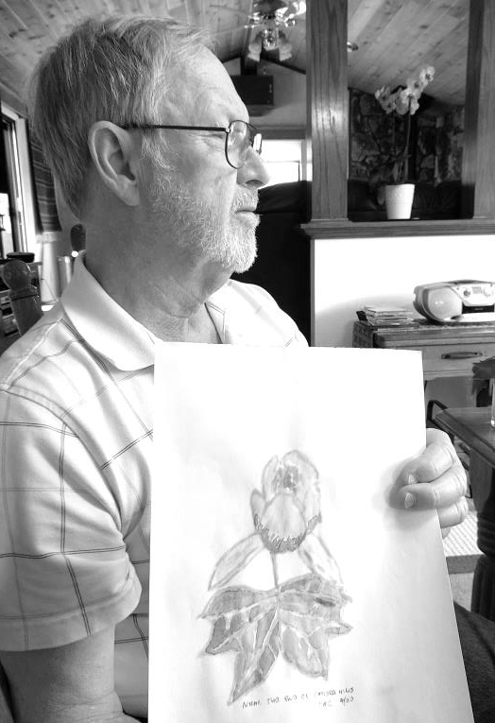
Online Exhibit
John

Slide 22
Online Exhibit
Chelsea

Slide 23
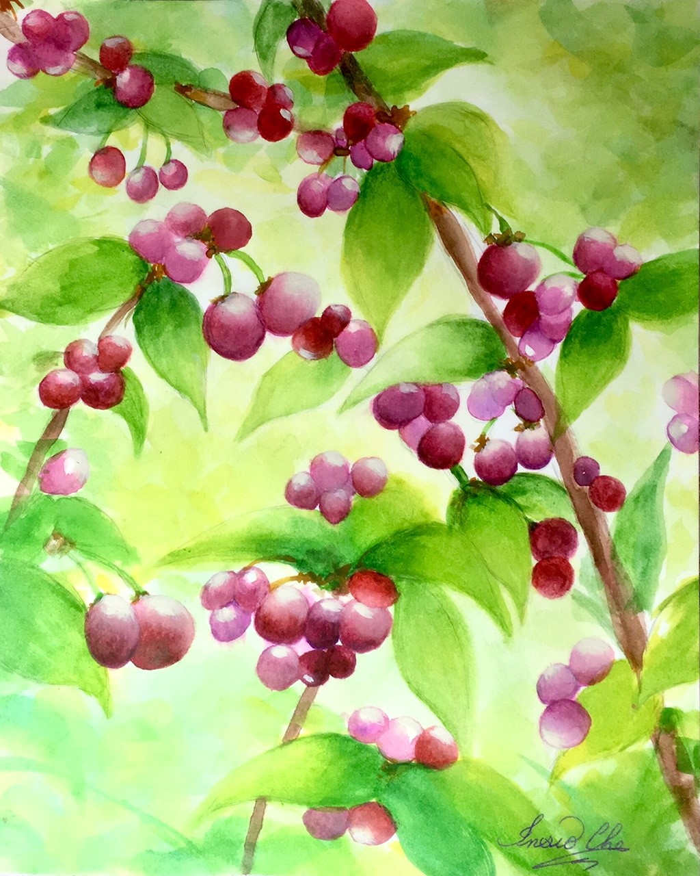
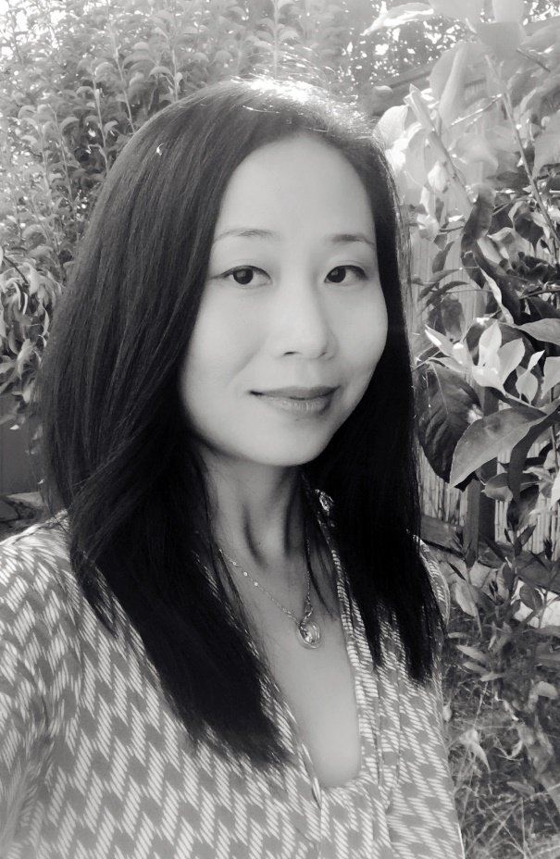
Online Exhibit
Insio

Slide 24
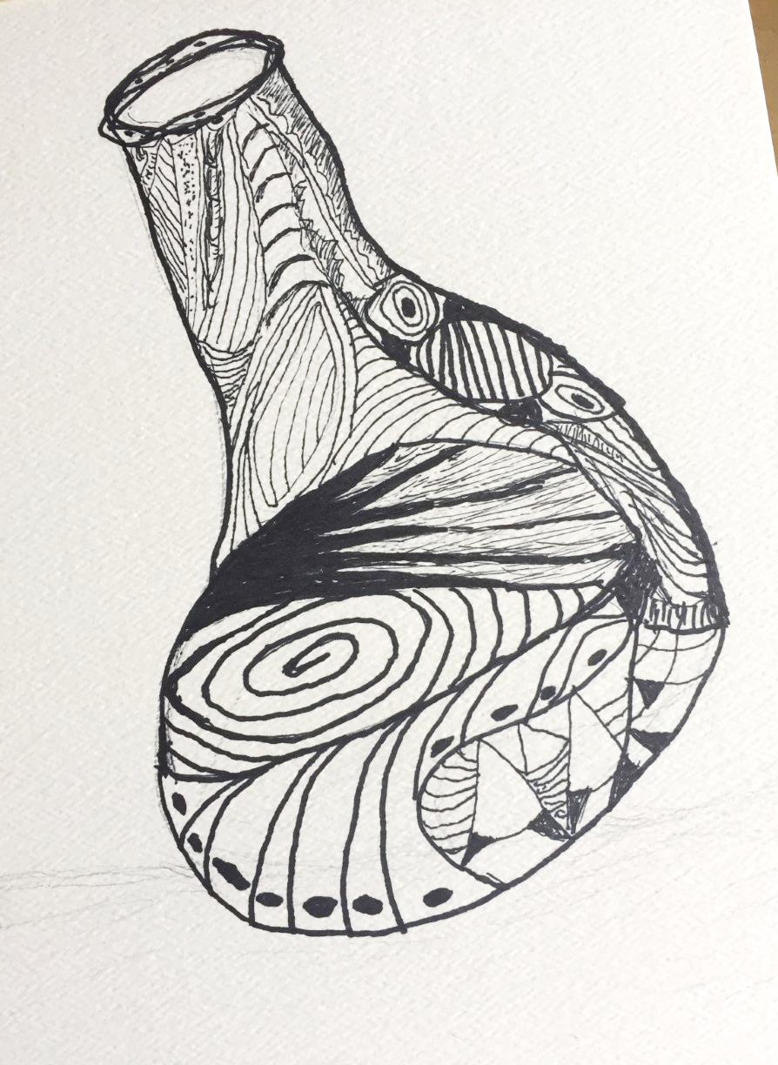
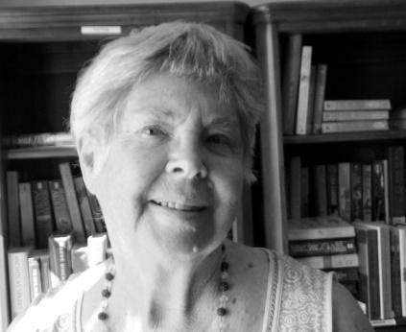
Online Exhibit
Susan

Slide 25
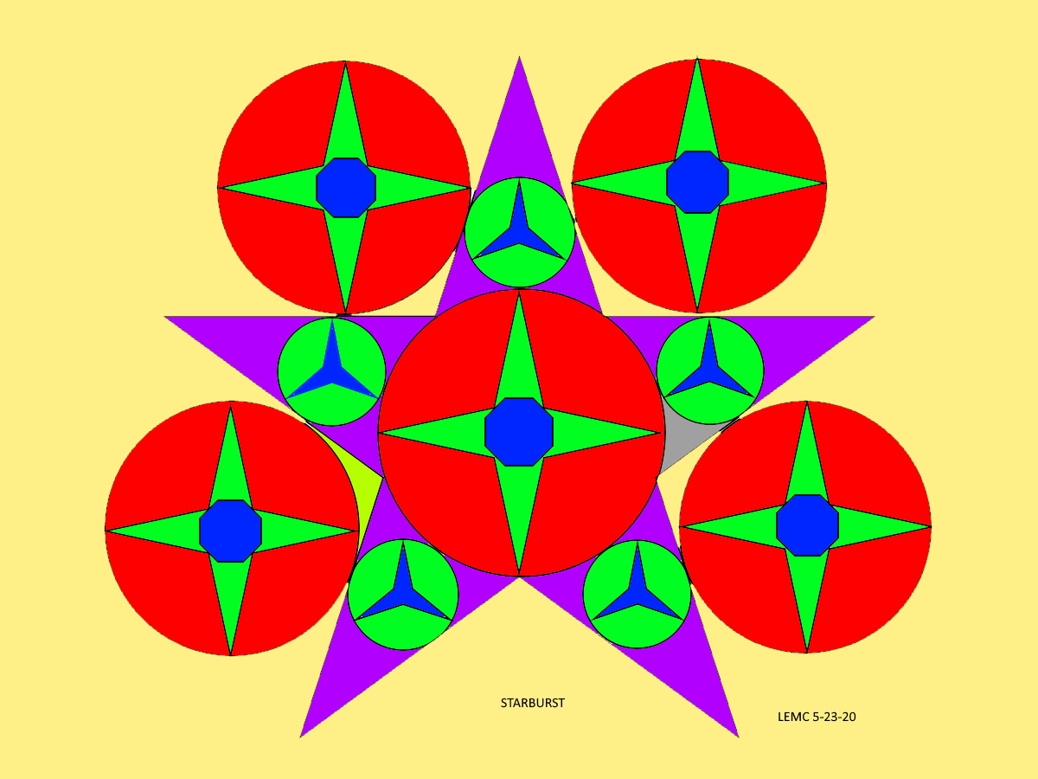
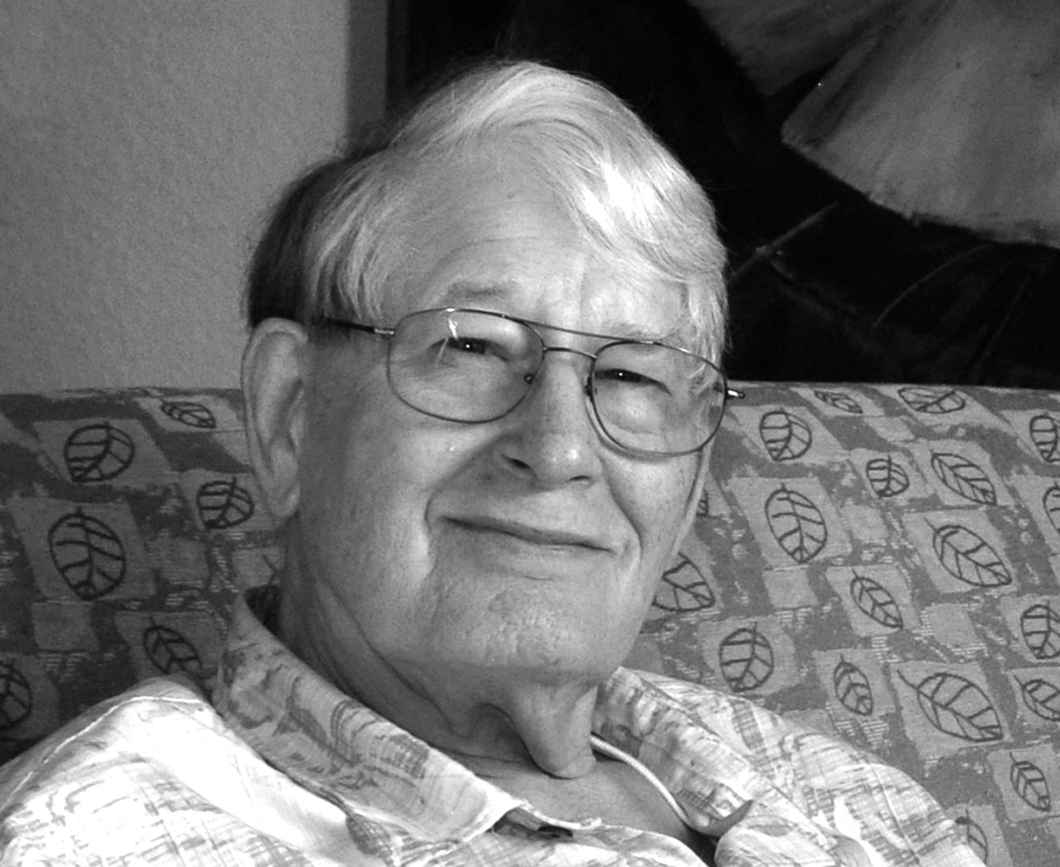
Online Exhibit
Larry

Slide 26
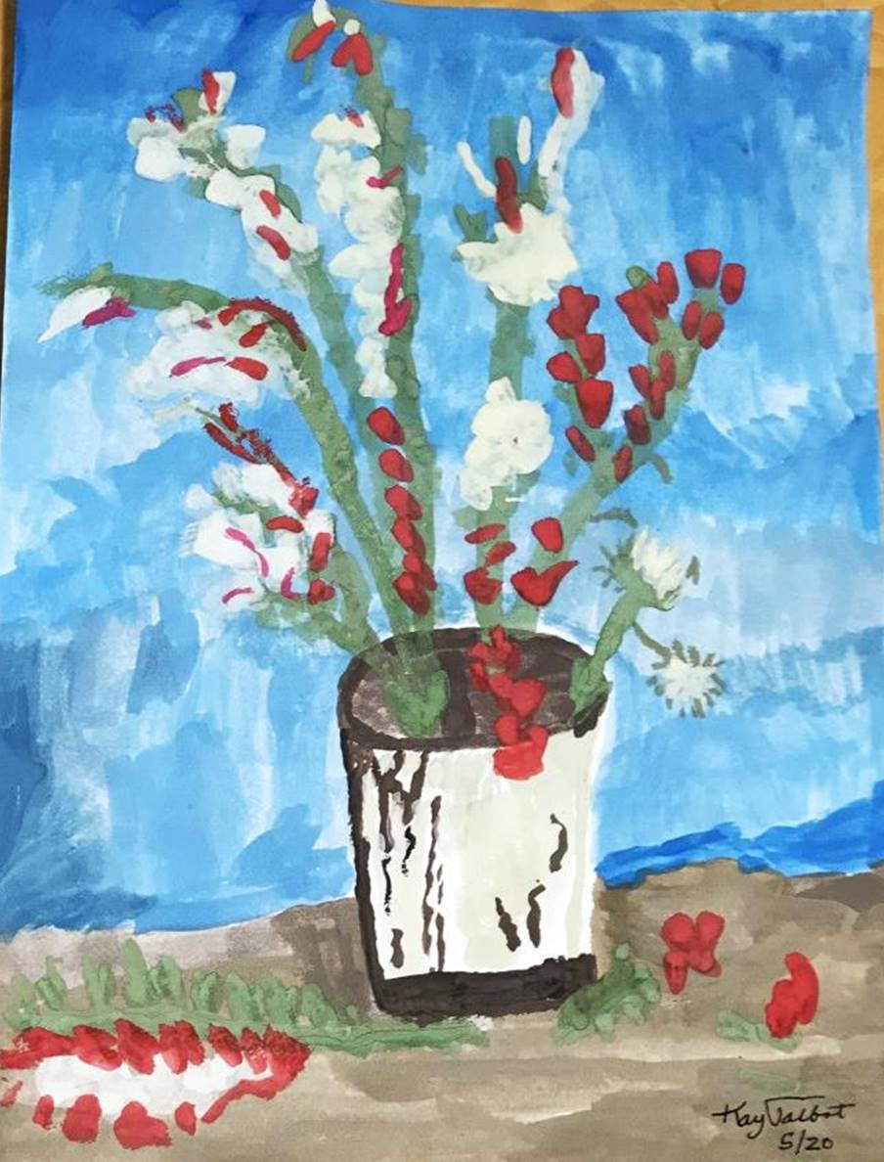
Online Exhibit
Kay

Slide 27
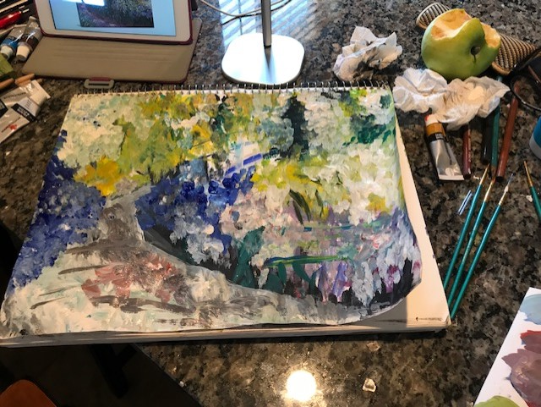
Online Exhibit
Pamela

Slide 28
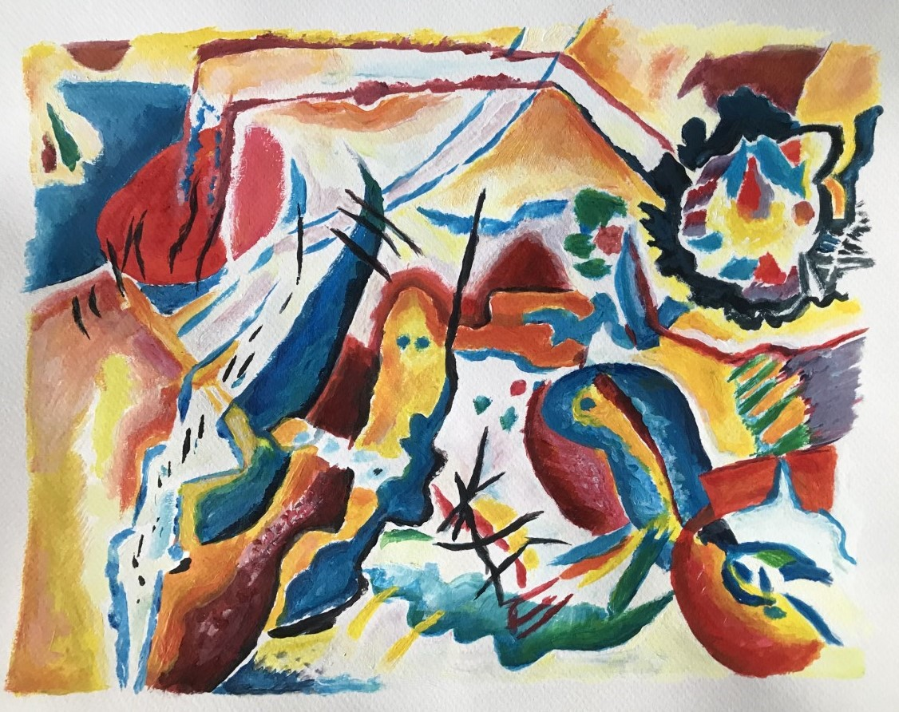
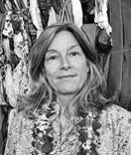
Online Exhibit
Darcie

Slide 29
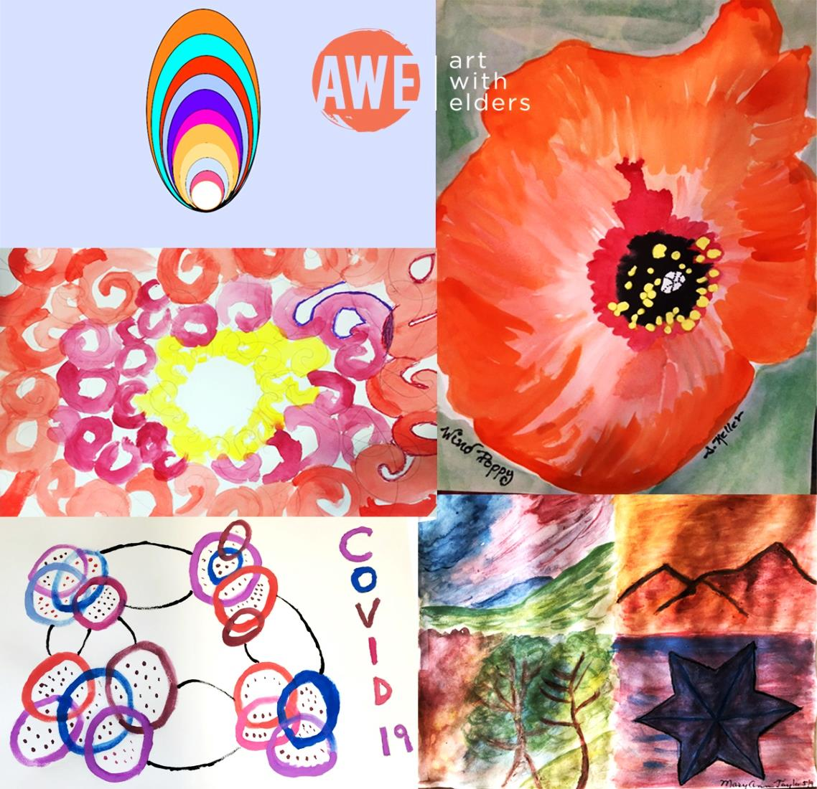
Art With Elders
AWEsome Art www.artwithelders.org
I hope you will enjoy and find value in our session. Your support helps keep our program and our artist instructors going. If you are able to give a donation for this class, we would greatly appreciate it. Thank you!
Donations may be made on our website at: www.artwithelders.org
Or by check, mail to:
Art With Elders
236 West Portal Ave. #845
San Francisco, CA 94131

Slide 30
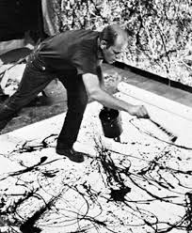
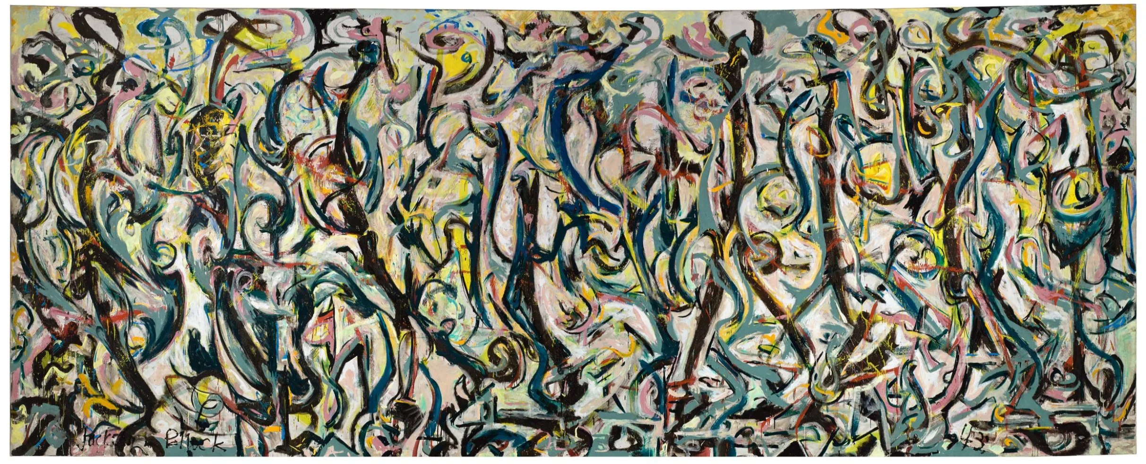
Inspiration – Jackson Pollack

Slide 31
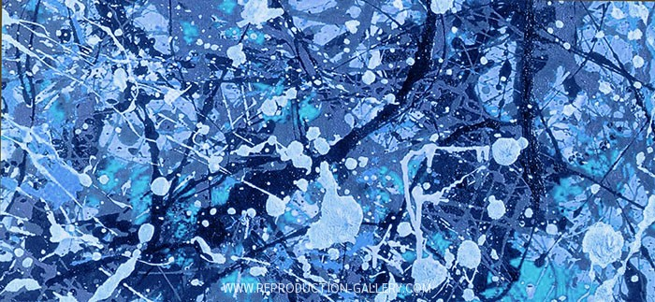
Inspiration – Jackson Pollack

Slide 32
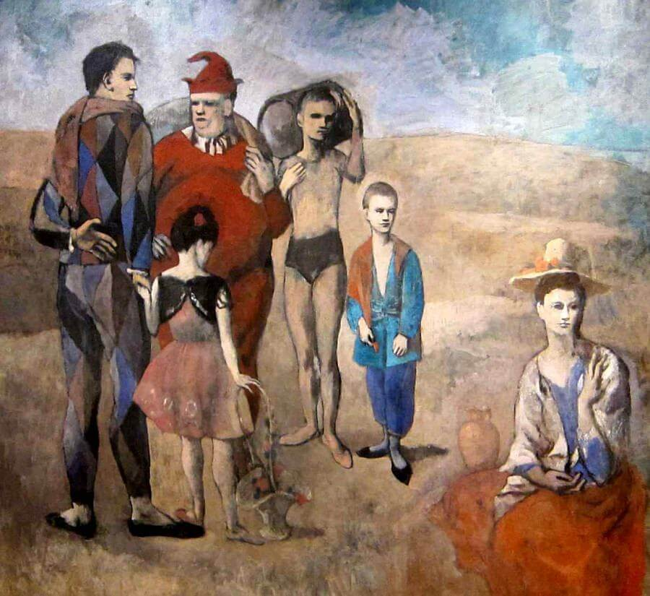
Inspiration – Pablo Picasso

Slide 33
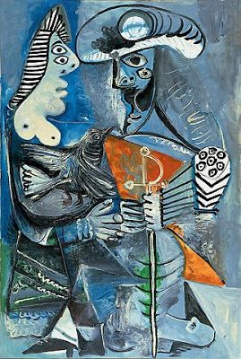
Inspiration – Pablo Picasso

